Slide 1
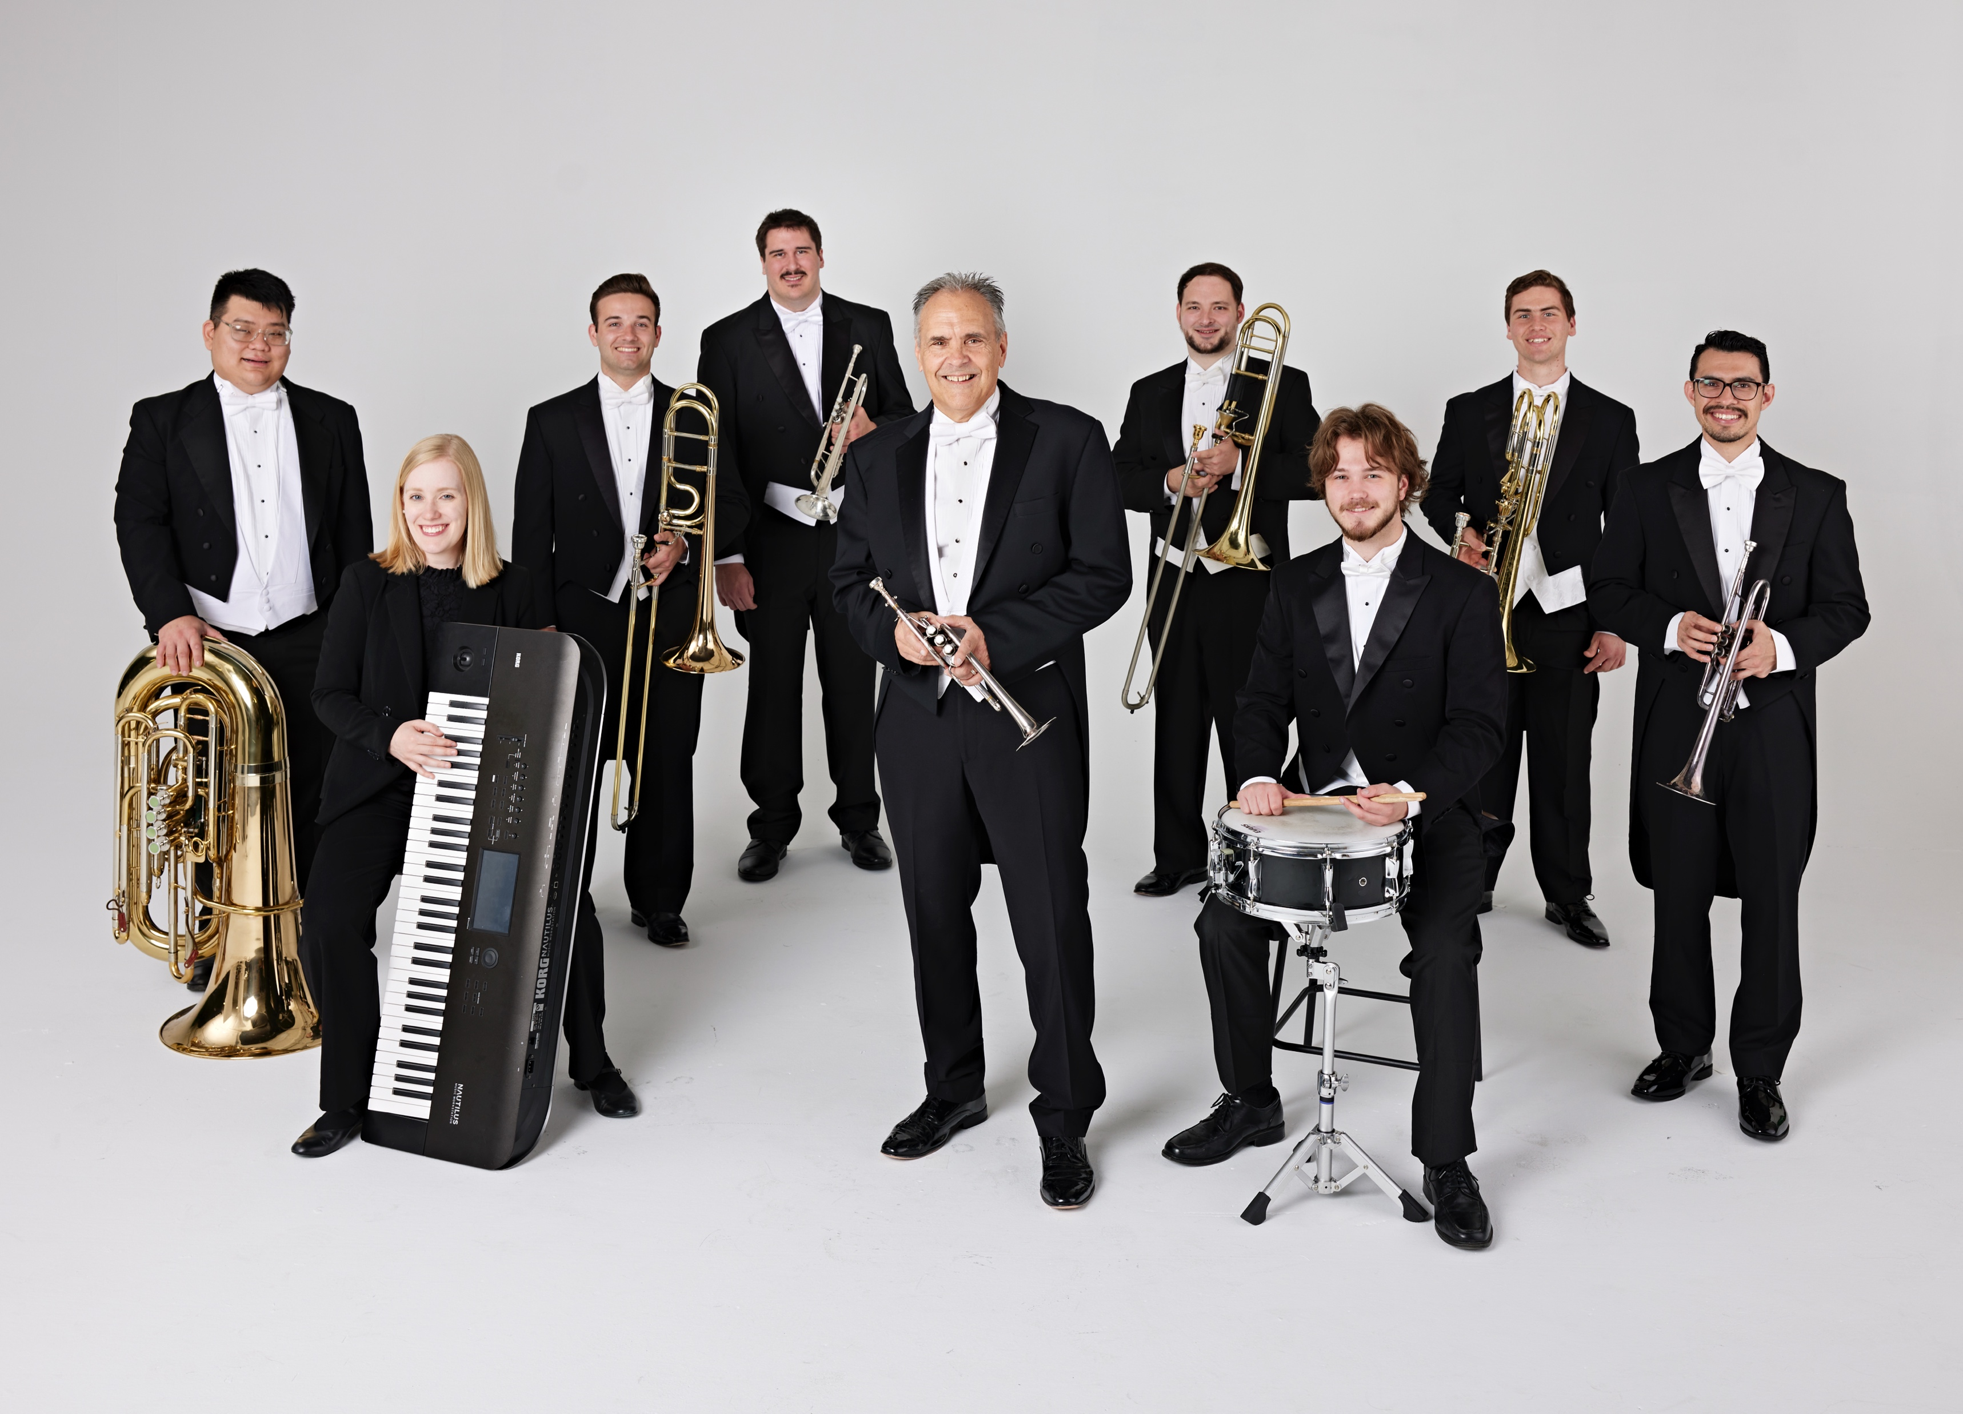

Tim Zimmerman &
The King’s Brass
Notes:
Please start Slide 2 AS SOON AS you hear “Welcome Tim Zimmerman & the King’s Brass,” or if the pastor just says “Amen” and walks off.

Slide 2

Praise to the Lord, the Almighty
Traditional / Arr. Dan Marvin
Notes:
After applause, immediately move to next slide.

Slide 3
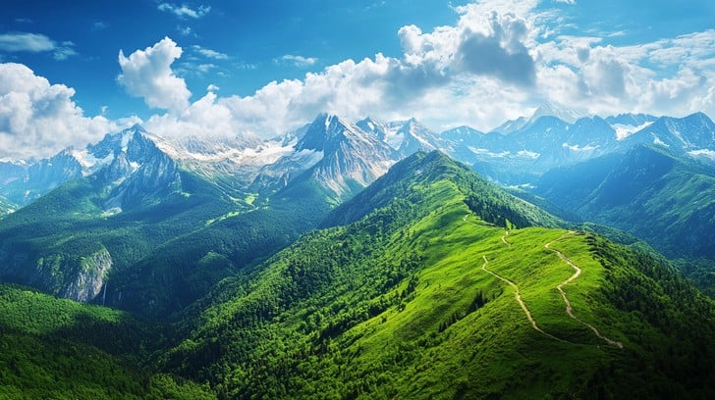
How Majestic Is Your Name
Michael W. Smith / Arr. Dan Marvin
Notes:
Move to next blank slide when the audience applauds at the end.

Slide 4

Come, Thou Fount of Every Blessing
John Wyeth / Arr. Dan Marvin
Notes:
Move to next blank slide when the audience applauds at the end.

Slide 5
Notes:
Move to “I Know Whom I Have Believed” when Tim finishes talking.

Slide 6
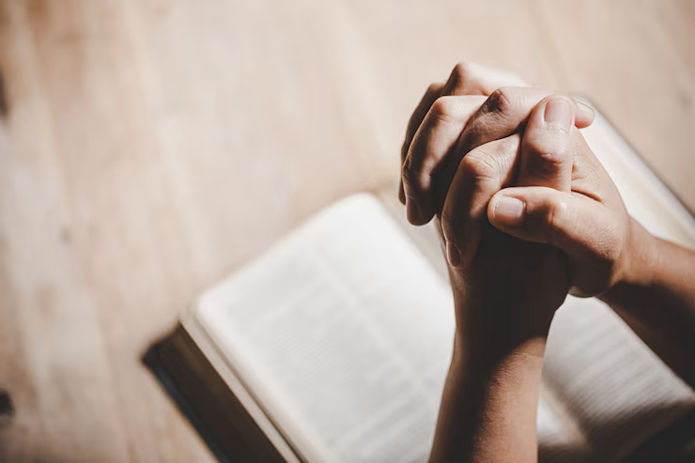
I Know Whom I Have Believed
James McGranahan / Arr. Dan Marvin
Notes:
Nothing will be said after this song is over. Move to next slide when you hear applause.

Slide 7
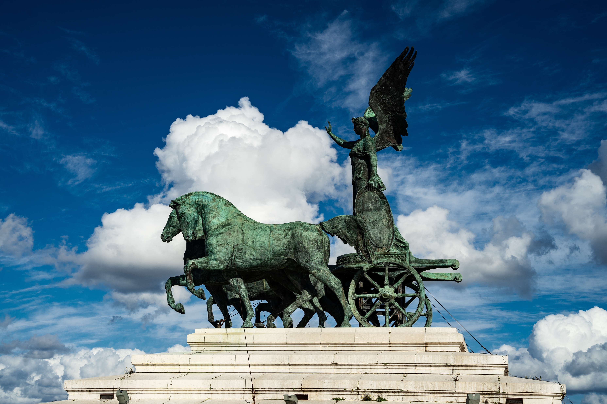
Swing Low
Traditional Spiritual / Arr. Dan Marvin

Slide 8
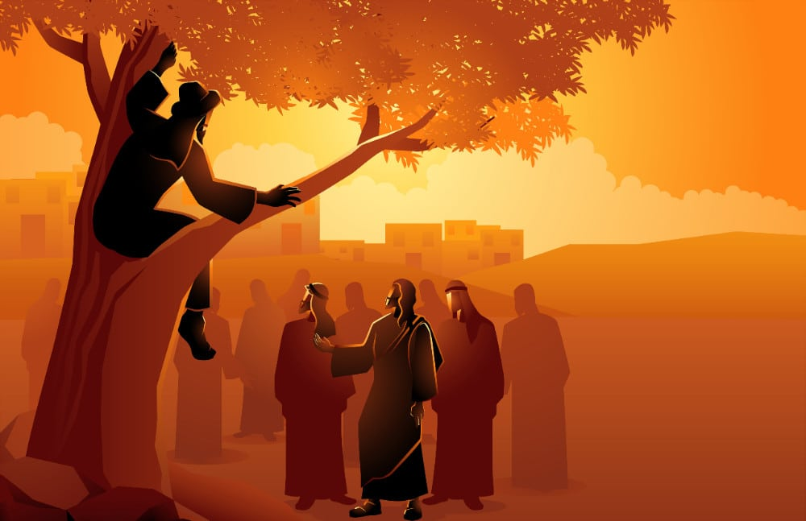
Zacchaeus – Kid’s Story
Traditional / Arr. Tim Zimmerman
Notes:
WAIT until King’s Brass member finishes introducing the “next set of typically American pieces” before moving to the next slide.

Slide 9
Notes:
Leave blank until end of the song.

Slide 10
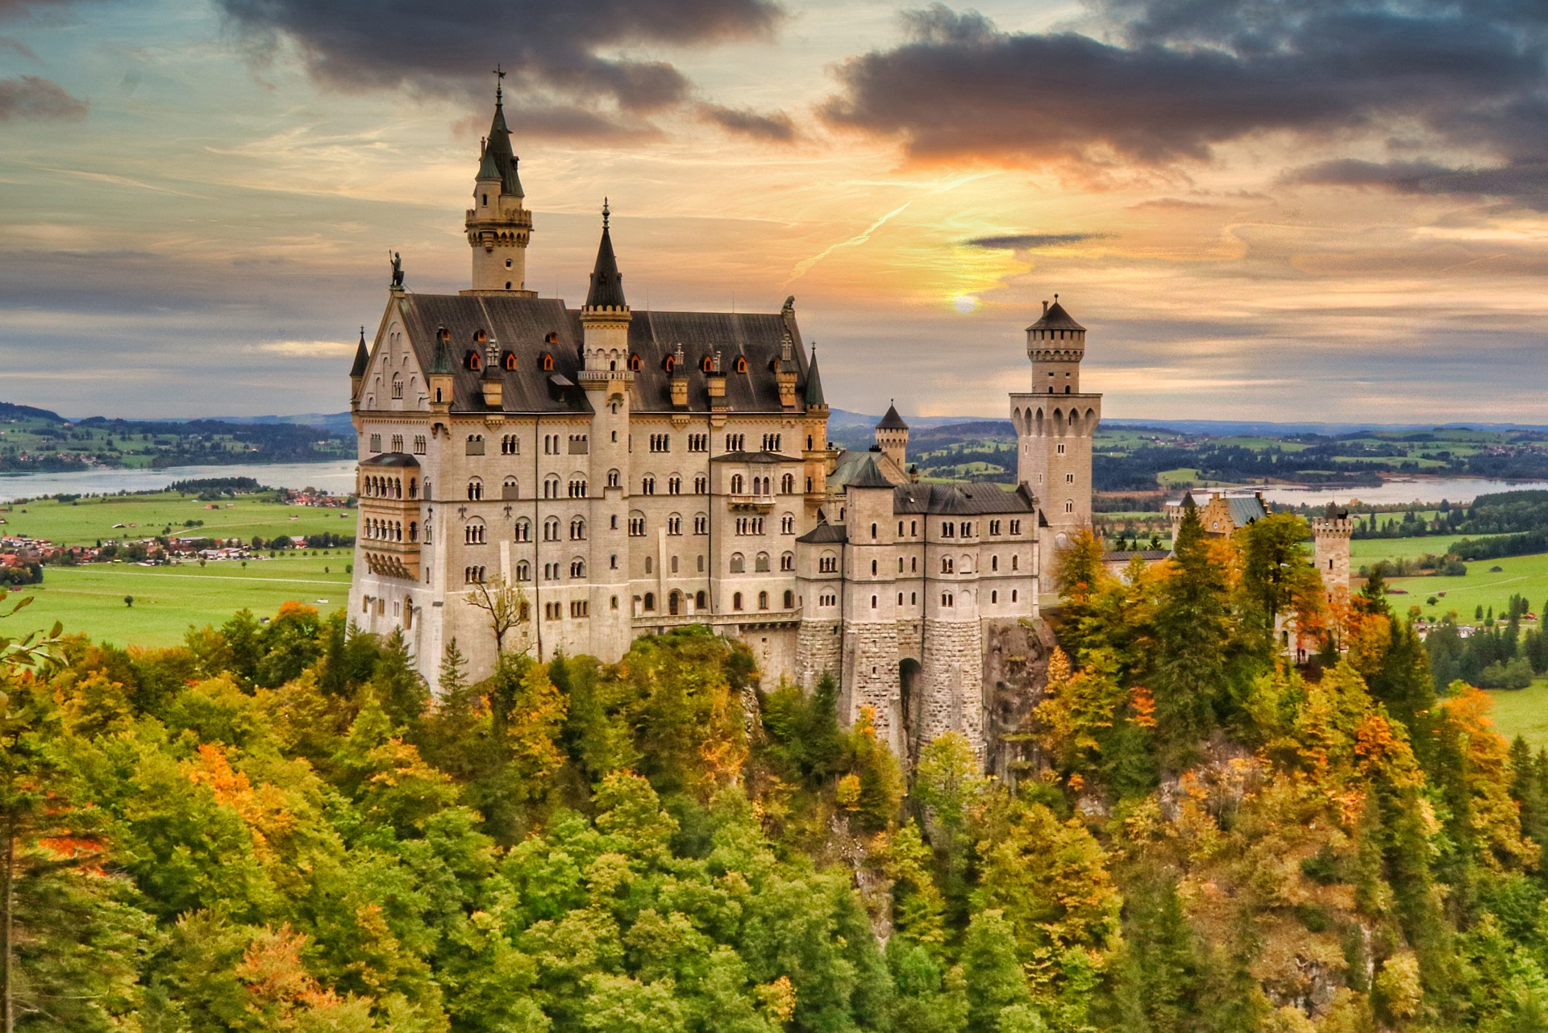
A Mighty Fortress is Our God
Martin Luther / Arr. Tim Zimmerman
Notes:
A KB member will tell the audience before the hymn starts to watch for a cue after an opening fanfare. DO NOT START THE LYRICS WHEN YOU HEAR THE MUSIC. Please wait until you hear Tim Zimmerman say, “PLEASE STAND and join us in singing…” before showing the first lyric slide.

Slide 11
A mighty Fortress is our God, a bulwark never failing;

Slide 12
Our helper He amid the flood of mortal ills prevailing.

Slide 13
For still our ancient foe doth seek to work us woe;

Slide 14
His craft and power are great, and armed with cruel hate,

Slide 15
On earth is not his equal.

Slide 16
Did we in our own strength confide, our striving would be losing;

Slide 17
Were not the right Man on our side,
The man of God’s own choosing.

Slide 18
Dost ask who that may be?
Christ Jesus, it is He;

Slide 19
Lord Sabaoth His name, from age to age the same,

Slide 20
And He must win the battle.

Slide 21
And tho’ this world, with devils filled,
Should threaten to undo us

Slide 22
We will not fear, for God hath willed
His truth to triumph thro’ us

Slide 23
The prince of darkness grim,
We tremble not for him

Slide 24
His rage we can endure
For lo, his doom is sure;

Slide 25
One little word shall fell him.

Slide 26
That word above all earthly powers,
No thanks to them, abideth;

Slide 27
The Spirit and the gifts are ours
Thru Him who with us sideth:

Slide 28
Let goods and kindred go, this mortal life also;

Slide 29
The body they may kill:
God’s truth abideth still,

Slide 30
His kingdom is forever.
© Public Domain
Notes:
Move to next slide when members start leaving the stage.

Slide 31
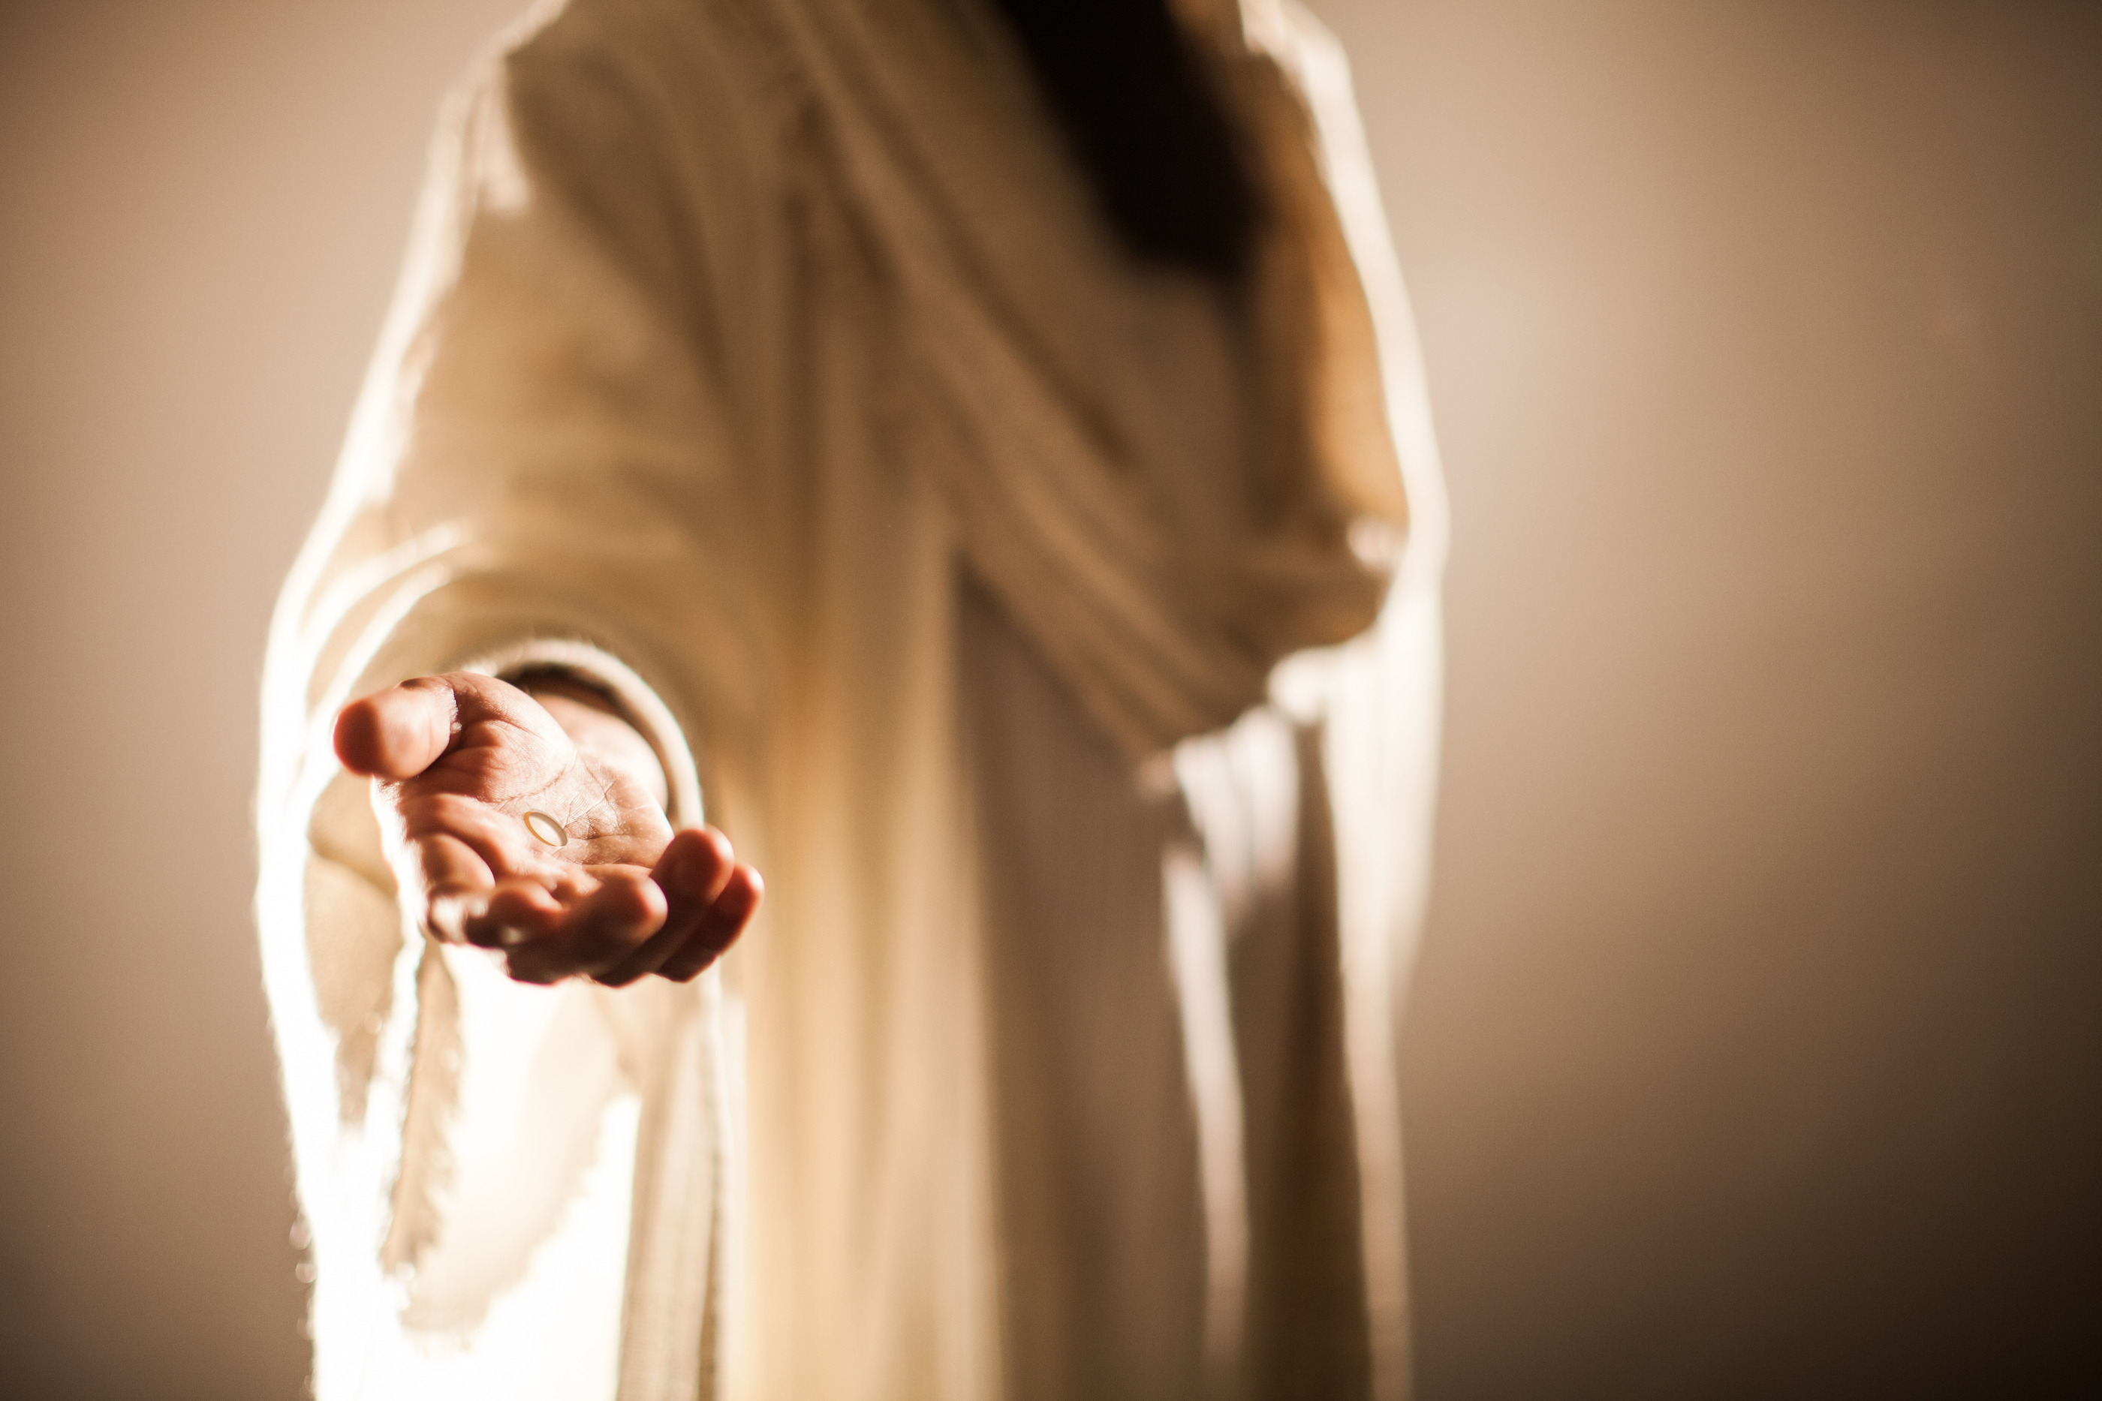
Jesus Loves Me
William Bradbury / Arr. Lisa Varner Nelson & Tim Zimmerman
Notes:
Move to the next slide when Tim starts talking again.

Slide 32
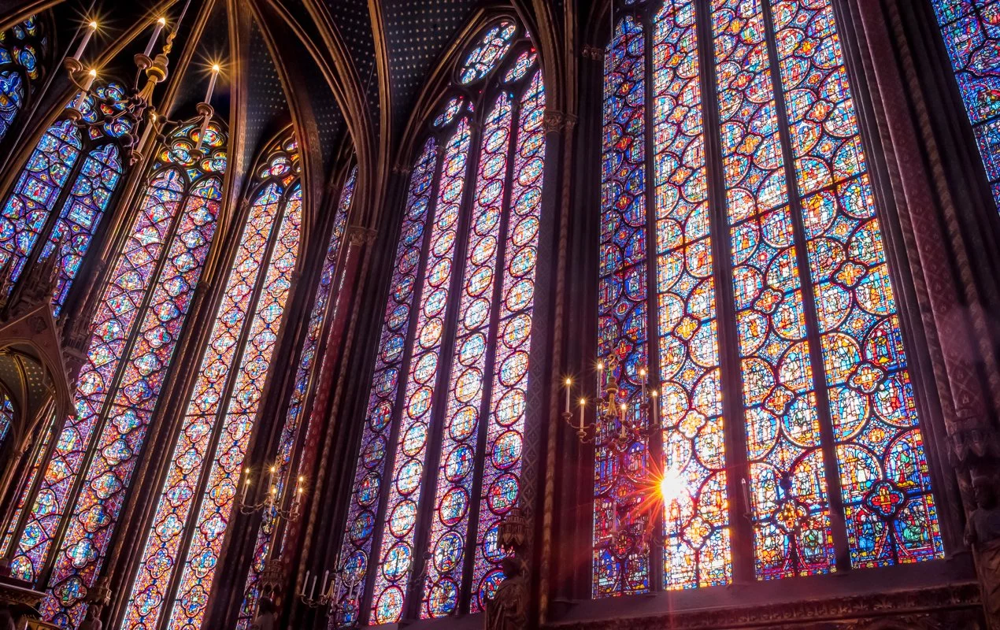
Christ the Lord is Risen Today
Traditional / Arr. Tim Zimmerman

Slide 33
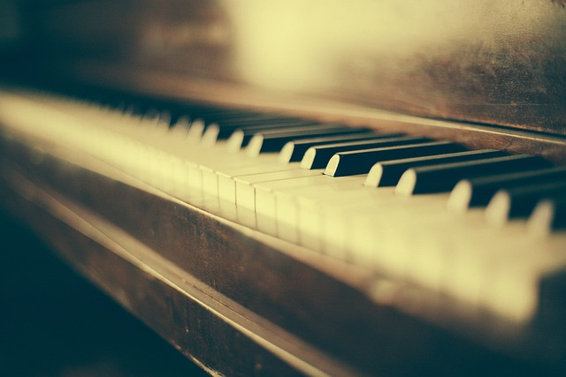
Praise, My Soul, the King of Heaven
Mark Andrews / Arr. Lenny Seidel
Notes:
Move to next slide immediately after this piano solo is done.

Slide 34
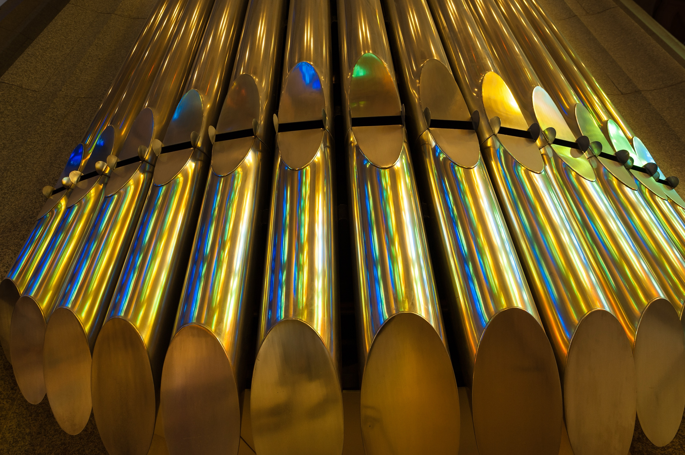
Nun danket alle Gott (Organ Piece)
Sigfried Karg-Elert

Slide 35
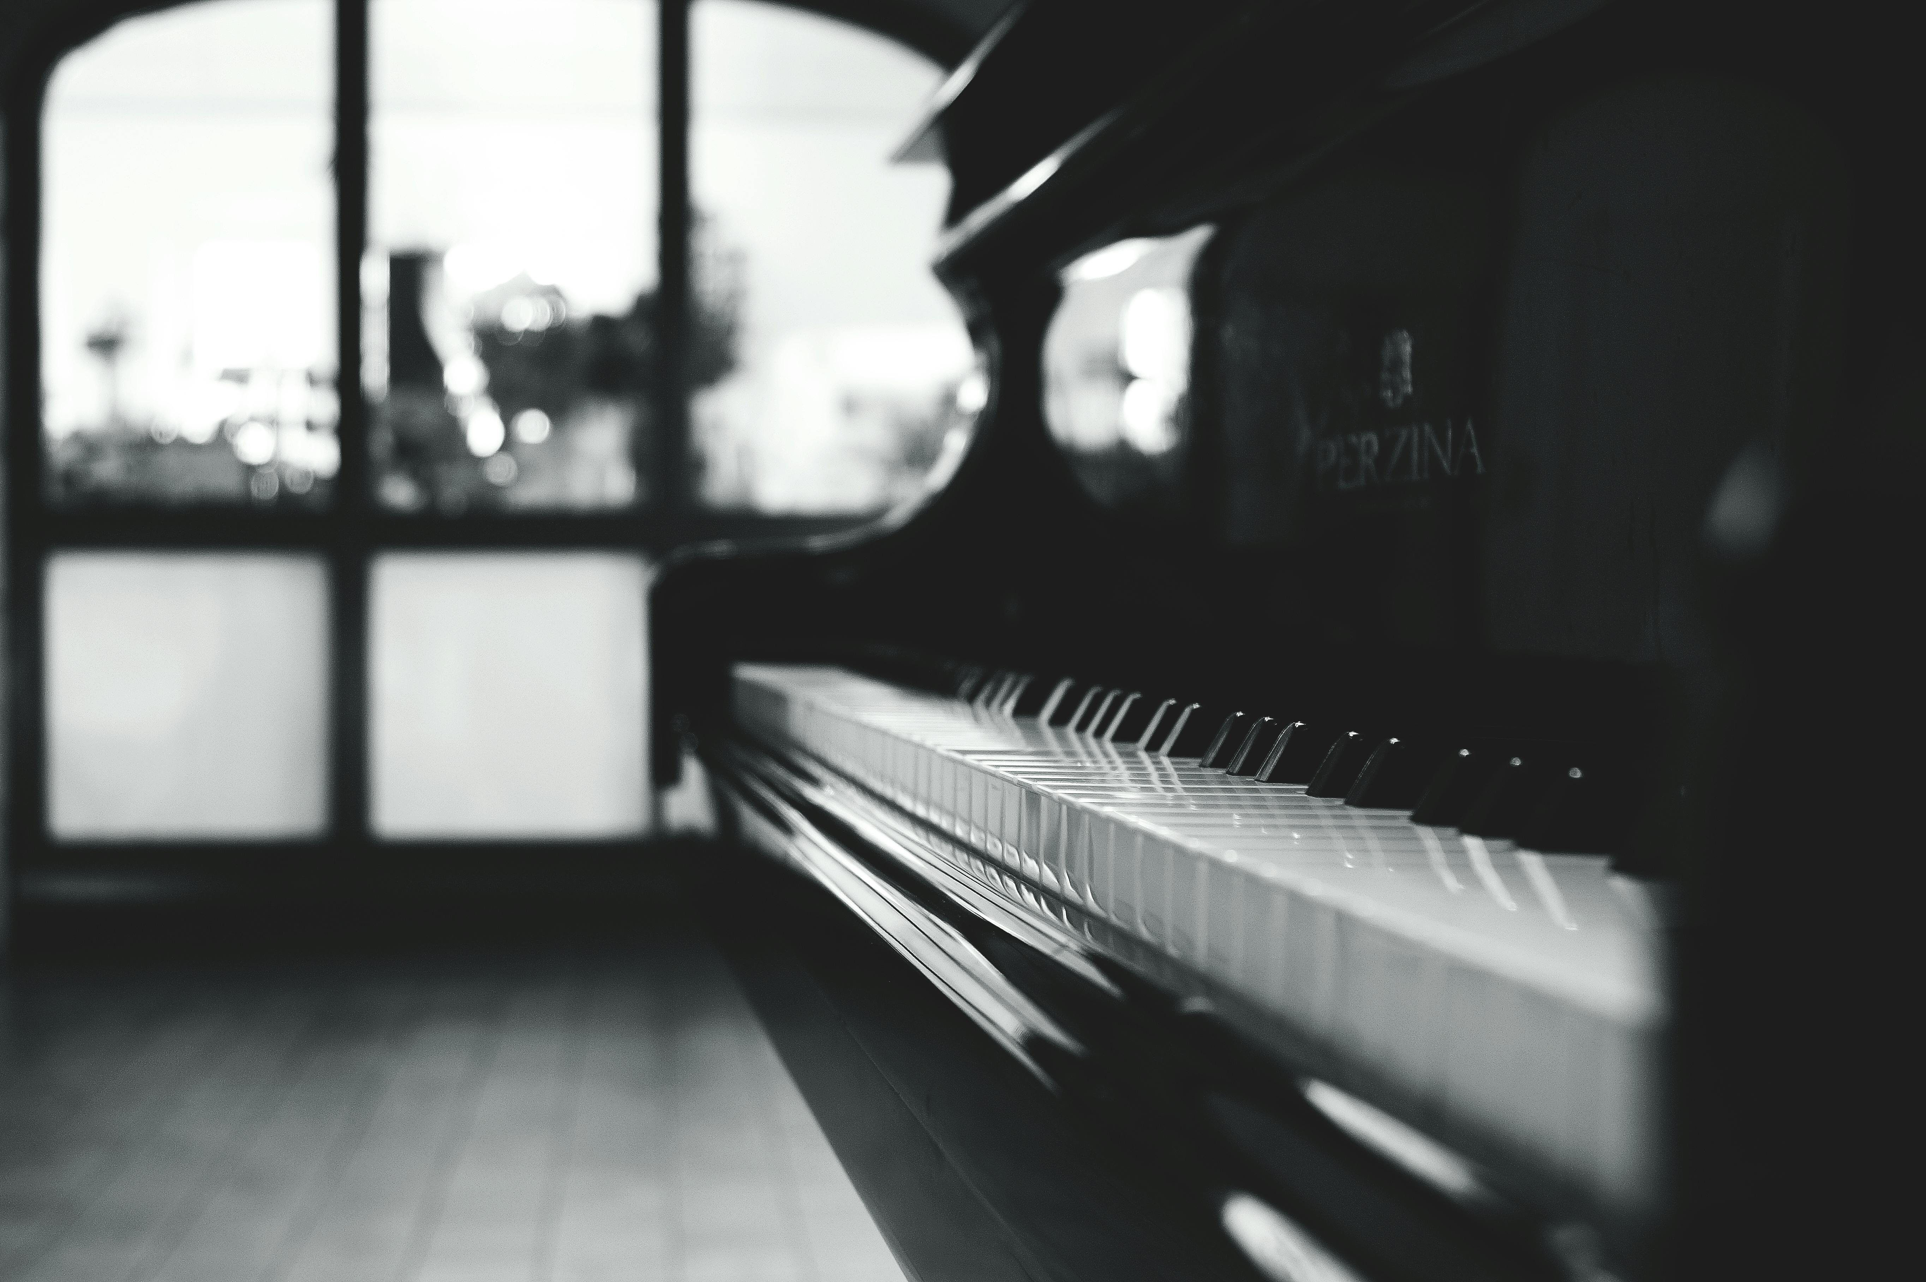
Blessed Assurance
Fanny Crosby / Arr. Lenny Seidel

Slide 36
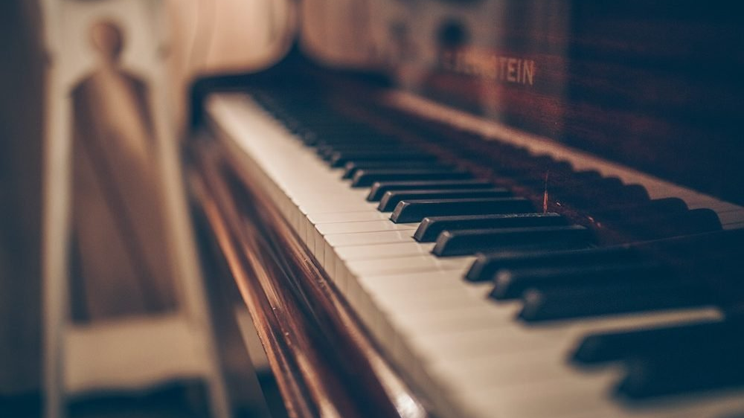
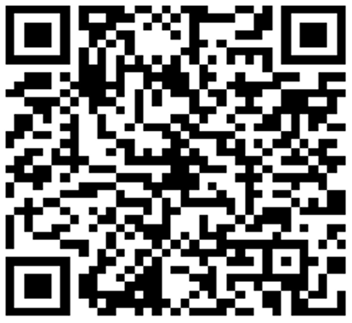
Offertory
If you would like to give online to the King’s Brass via credit card, turn on your smartphone’s camera and point it toward this QR code. Follow the link to the website on your browser where you can give.

Slide 37
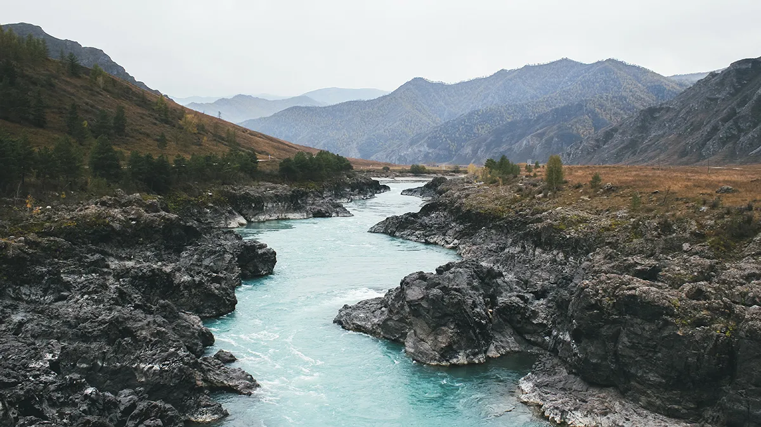
Down by the Riverside
Traditional Spiritual / Arr. David Gravesen
Notes:
There are two halves: a slow first, and faster second. The audience will clap at the end of the slow one, thinking it is over. Do not change slides. WAIT until the faster half is done.

Slide 38
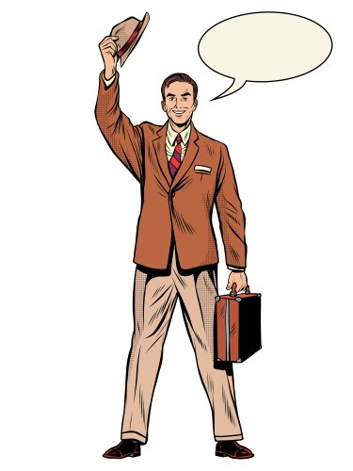
Group Parable – The Vacuum Cleaner
John Duckworth
Want a vacuum cleaner???
Notes:
When music starts at the end of the skit, move to the next slide.

Slide 39

Amazing Grace
Traditional / Arr. Dan Marvin
Notes:
Please do not show lyrics when you hear music. WAIT until Tim says “Please STAND and join us in singing…” before showing lyrics on the next slide.

Slide 40
Amazing grace! How sweet the sound
That saved a wretch like me!

Slide 41
I once was lost but now am found;
Was blind, but now I see.

Slide 42
'Twas grace that taught my heart to fear,
And grace my fears relieved.

Slide 43
How precious did that grace appear
The hour I first believed.

Slide 44
When we’ve been there ten thousand years,
Bright shining as the sun,

Slide 45
We’ve no less days to sing God’s praise
Than when we’d first begun.
© Public Domain
Notes:
Move to next slide after the audience sings “BEGUN.”

Slide 46
Notes:
Leave BLANK until Tim finishes talking and starts playing. Will take about 5 minutes.

Slide 47

You Are My All In All
D. Jernigan / Arr. Lisa Varner Nelson
Notes:
Please WAIT until Tim says “Join us…” to start the lyrics.

Slide 48
You are my strength when I am weak,
You are the treasure that I seek;
You are my all in all.

Slide 49
Seeking You as a precious jewel,
Lord, to give up, I’d be a fool;
You are my all in all.

Slide 50
Jesus, Lamb of God, Worthy is Your Name!
Jesus, Lamb of God, Worthy is Your Name!
© 1990 Shepherd’s Heart Music
Notes:
Move to next slide when audience sings the last ”Name”

Slide 51
Notes:
Leave blank until the audience applauses and Tim introduces the final song.

Slide 52
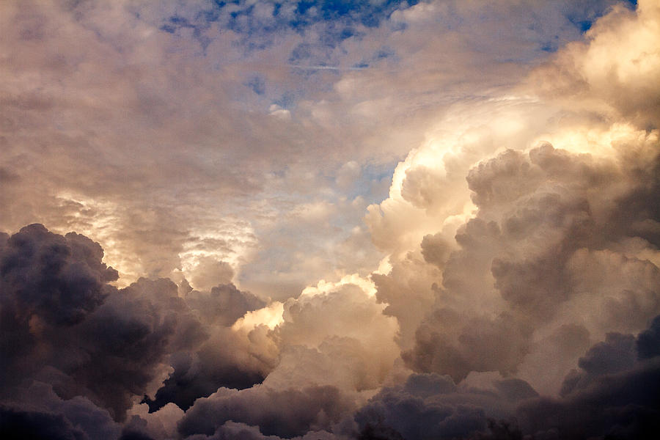
God of Our Fathers
George Warren / Arr. Tim Zimmerman
Notes:
Move to final slide after the applause.

Slide 53

O Happy Day
Traditional Spiritual / Arr. Lisa Varner Nelson
Notes:
Move to final slide after the applause.

Slide 54

Great Is The Lord
Michael W. and Deborah D. Smith / Arr. Bryan Nelson
Notes:
Move to final slide after the applause.

Slide 55
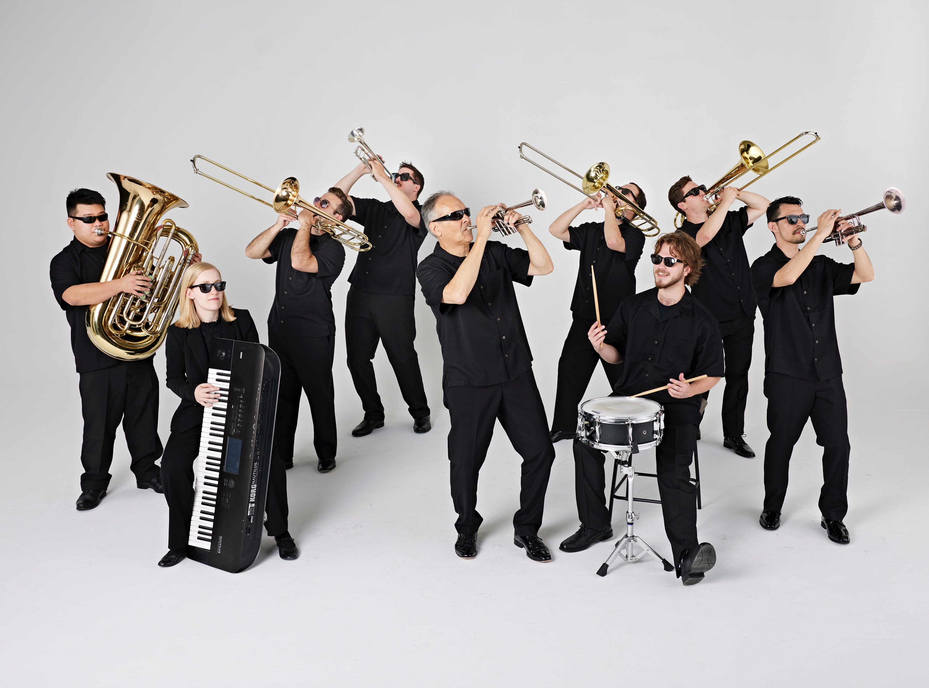
Tim Zimmerman &
The King’s Brass
Notes:
Leave here for remainder of concert. No slides needed for any encore pieces we play. Thanks for doing this! ☺

