Slide 1
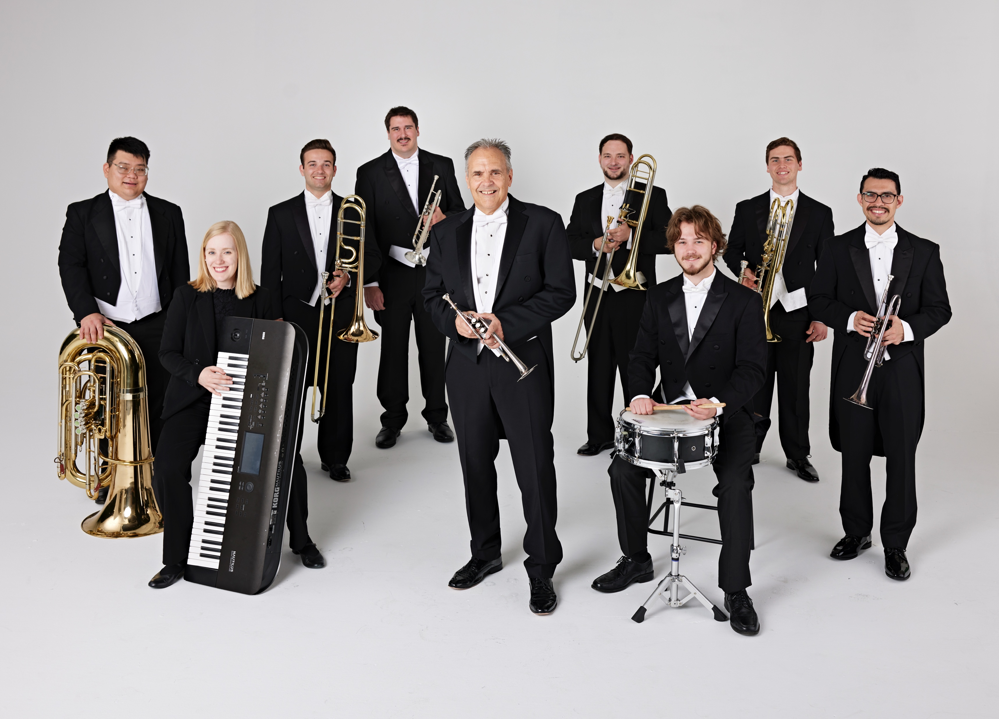

Tim Zimmerman &
The King’s Brass
Notes:
Please start Slide 2 AS SOON AS you hear “Welcome Tim Zimmerman & the King’s Brass,” or if the pastor just says “Amen” and walks off.

Slide 2

Praise to the Lord, the Almighty
Traditional / Arr. Dan Marvin
Notes:
After applause, immediately move to next slide.

Slide 3

How Majestic Is Your Name
Michael W. Smith / Arr. Dan Marvin
Notes:
Move to next blank slide when the audience applauds at the end.

Slide 4

Come, Thou Fount of Every Blessing
John Wyeth / Arr. Dan Marvin
Notes:
Move to next blank slide when the audience applauds at the end.

Slide 5
Notes:
Move to “I Know Whom I Have Believed” when Tim finishes talking.

Slide 6
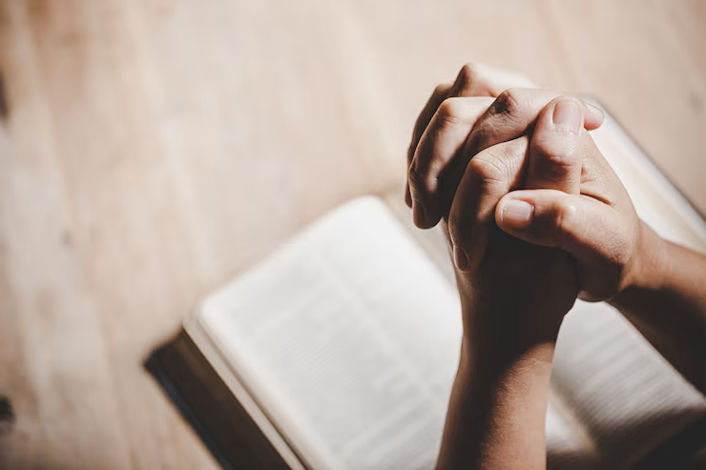
I Know Whom I Have Believed
James McGranahan / Arr. Dan Marvin
Notes:
Nothing will be said after this song is over. Move to next slide when you hear applause.

Slide 7
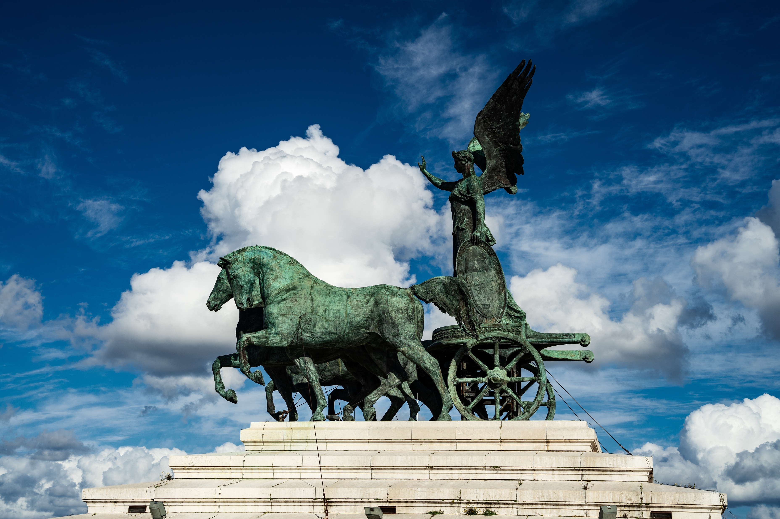
Swing Low
Traditional Spiritual / Arr. Dan Marvin
Notes:
Move to next slide when Tim says “YANKEE DOODLE”

Slide 8

Yankee Doodle
Morton Gould / Arr. Ardis Faber
Notes:
Move to next slide when you hear applause at the end.

Slide 9
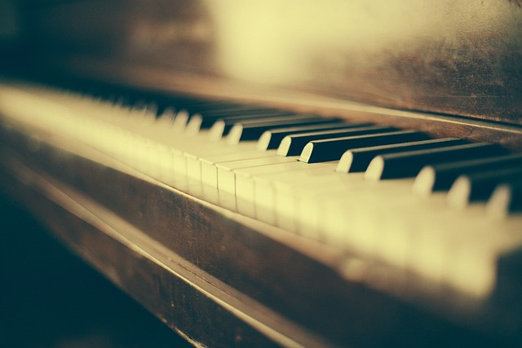
Praise, My Soul, the King of Heaven
Mark Andrews / Arr. Lenny Seidel
Notes:
Move to next slide immediately after this piano solo is done.

Slide 10
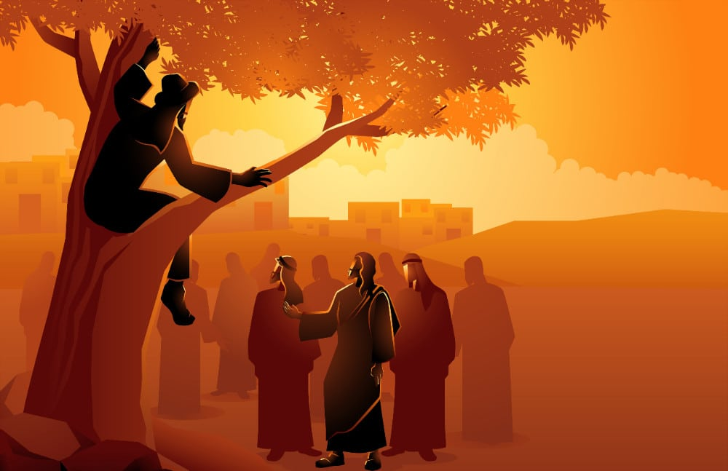
Zacchaeus – Kid’s Story
Traditional / Arr. Tim Zimmerman
Notes:
WAIT until King’s Brass member finishes introducing the “next set of typically American pieces” before moving to the next slide.

Slide 11

The Stars & Stripes Forever
John Philip Sousa / Arr. Phil Norris
Notes:
Move to next slide after the applause. Nothing will be said.

Slide 12
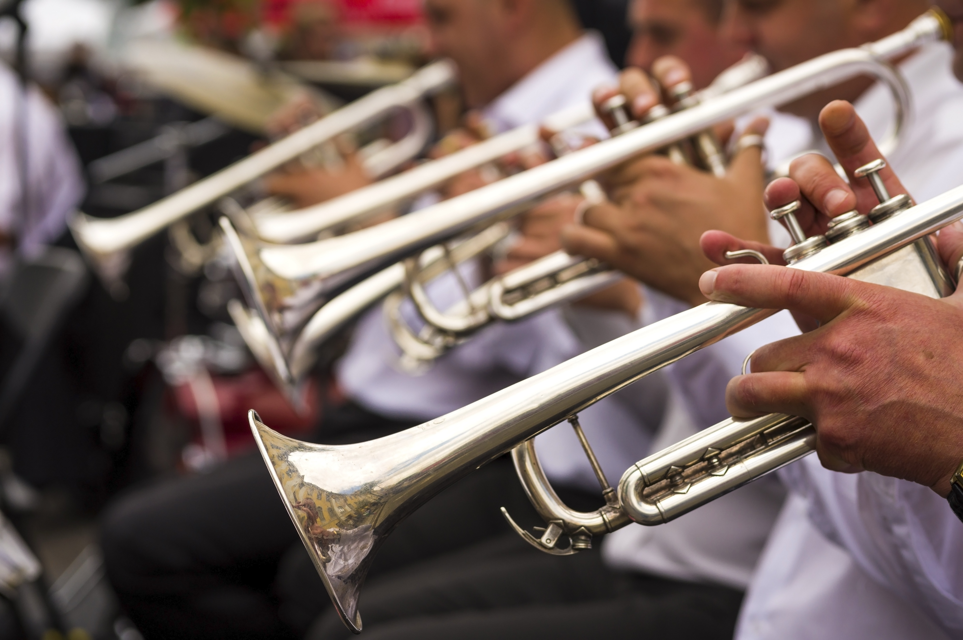
St. Louis Blues March
W.C. Handy / Arr. Jerry Gray & Ardis Faber
Notes:
Move to next slide after the applause. Nothing will be said.

Slide 13
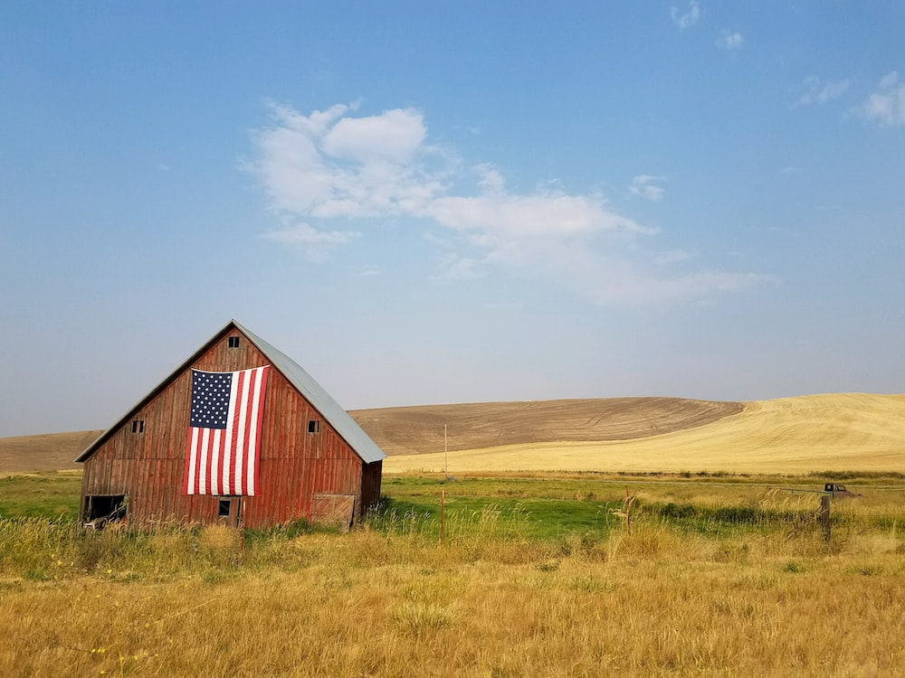
God Bless America
Irving Berlin / Arr. Lisa Nelson
Notes:
WAIT until Tim says, “Please STAND and join us in singing…” before moving to the next slide.

Slide 14
God bless America,
Land that I love

Slide 15
Stand beside her and guide her,

Slide 16
Through the night with the light from above.

Slide 17
From the mountains, to the prairies,

Slide 18
To the ocean, white with foam

Slide 19
God bless America, my home sweet home

Slide 20
God bless America, my home sweet home
©Irving Berlin Music Company
Notes:
Move to next slide after final “home.”

Slide 21
Notes:
Leave blank until end of the song.

Slide 22
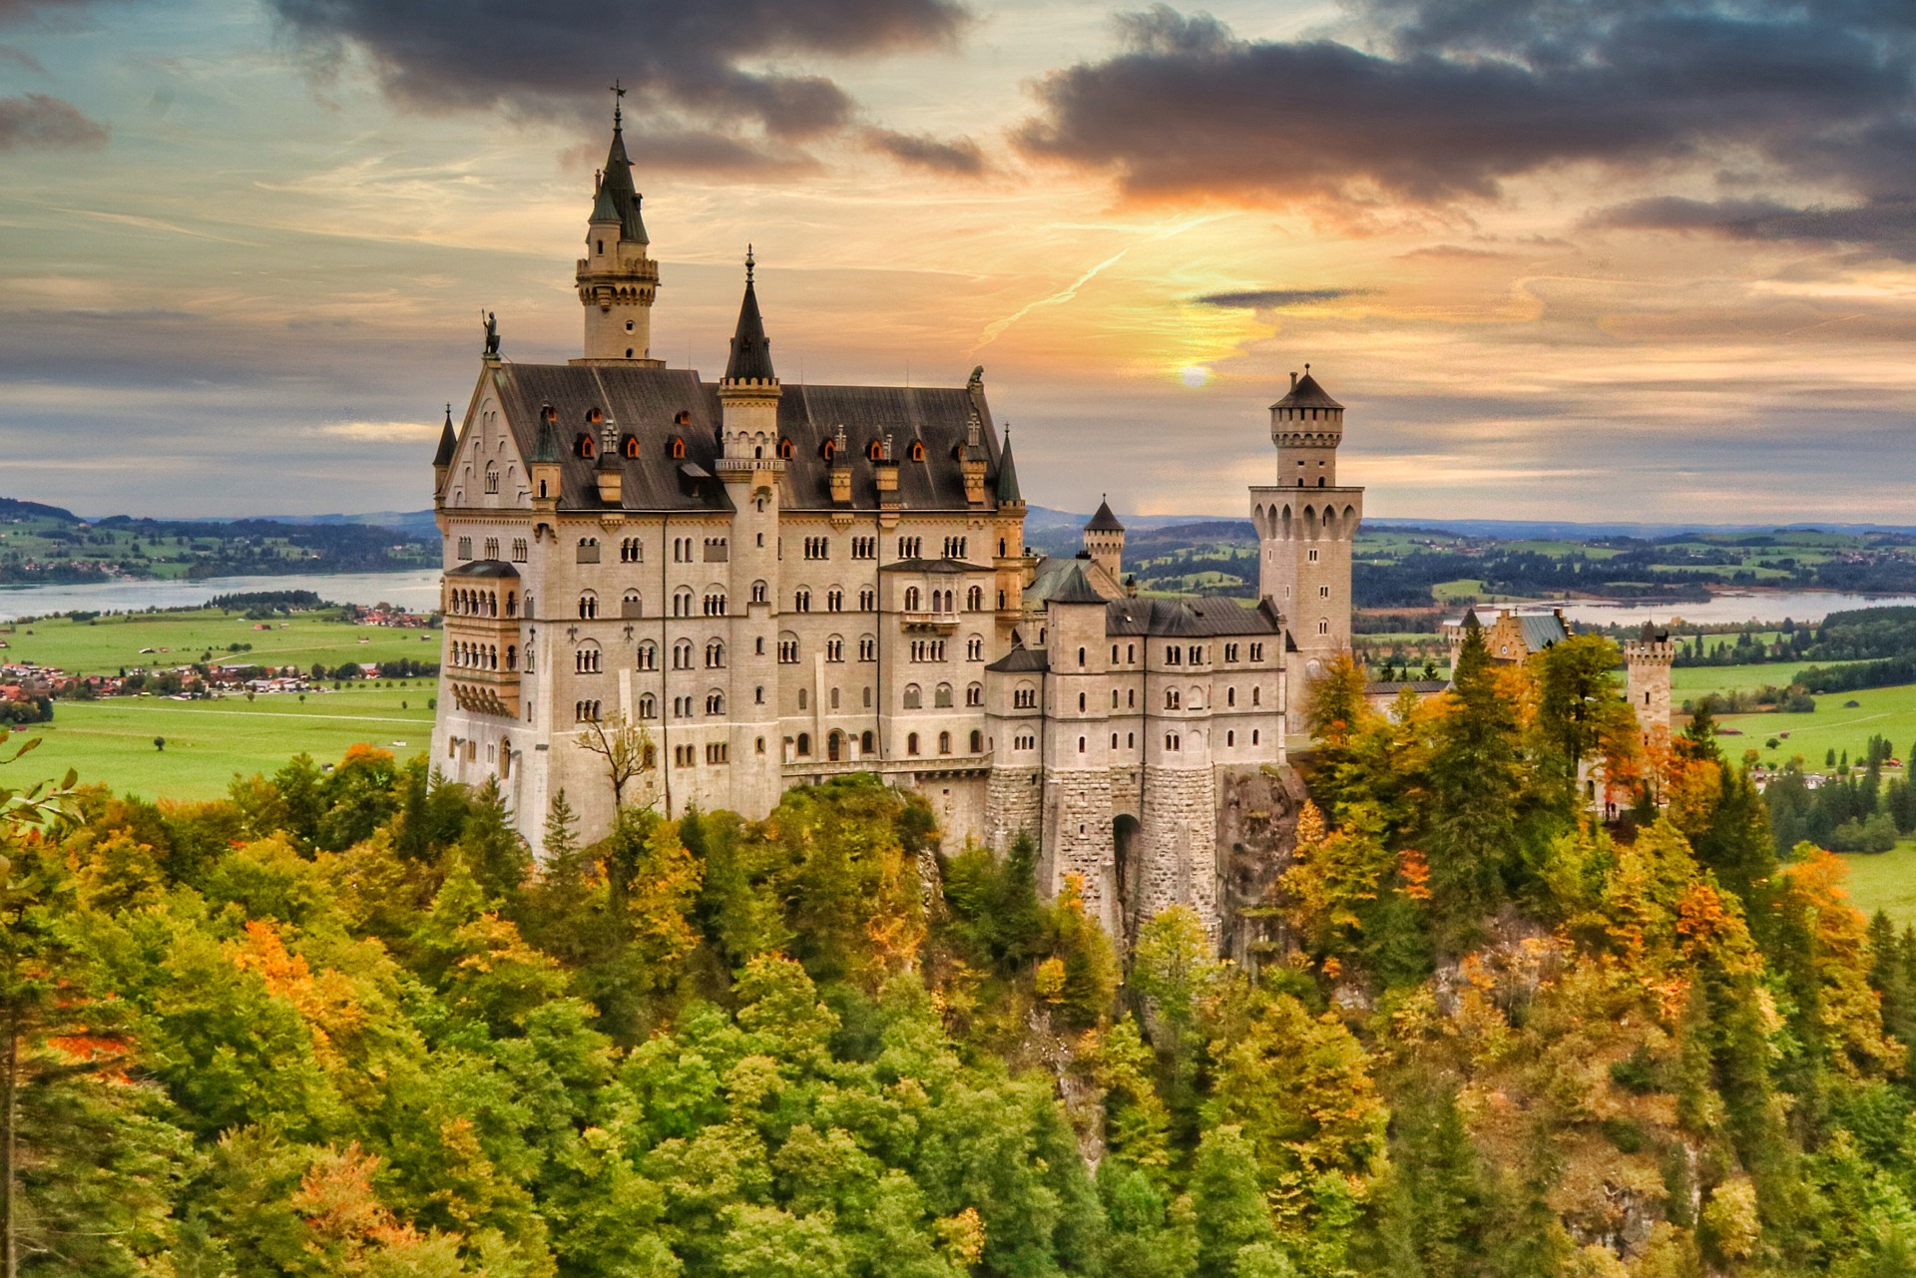
A Mighty Fortress is Our God
Martin Luther / Arr. Tim Zimmerman
Notes:
A KB member will tell the audience before the hymn starts to watch for a cue after an opening fanfare. DO NOT START THE LYRICS WHEN YOU HEAR THE MUSIC. Please wait until you hear Tim Zimmerman say, “PLEASE STAND and join us in singing…” before showing the first lyric slide.

Slide 23
A mighty Fortress is our God, a bulwark never failing;

Slide 24
Our helper He amid the flood of mortal ills prevailing.

Slide 25
For still our ancient foe doth seek to work us woe;

Slide 26
His craft and power are great, and armed with cruel hate,

Slide 27
On earth is not his equal.

Slide 28
Did we in our own strength confide, our striving would be losing;

Slide 29
Were not the right Man on our side,
The man of God’s own choosing.

Slide 30
Dost ask who that may be?
Christ Jesus, it is He;

Slide 31
Lord Sabaoth His name, from age to age the same,

Slide 32
And He must win the battle.

Slide 33
And tho’ this world, with devils filled,
Should threaten to undo us

Slide 34
We will not fear, for God hath willed
His truth to triumph thro’ us

Slide 35
The prince of darkness grim,
We tremble not for him

Slide 36
His rage we can endure
For lo, his doom is sure;

Slide 37
One little word shall fell him.

Slide 38
That word above all earthly powers,
No thanks to them, abideth;

Slide 39
The Spirit and the gifts are ours
Thru Him who with us sideth:

Slide 40
Let goods and kindred go, this mortal life also;

Slide 41
The body they may kill:
God’s truth abideth still,

Slide 42
His kingdom is forever.
© Public Domain
Notes:
Move to next slide when members start leaving the stage.

Slide 43
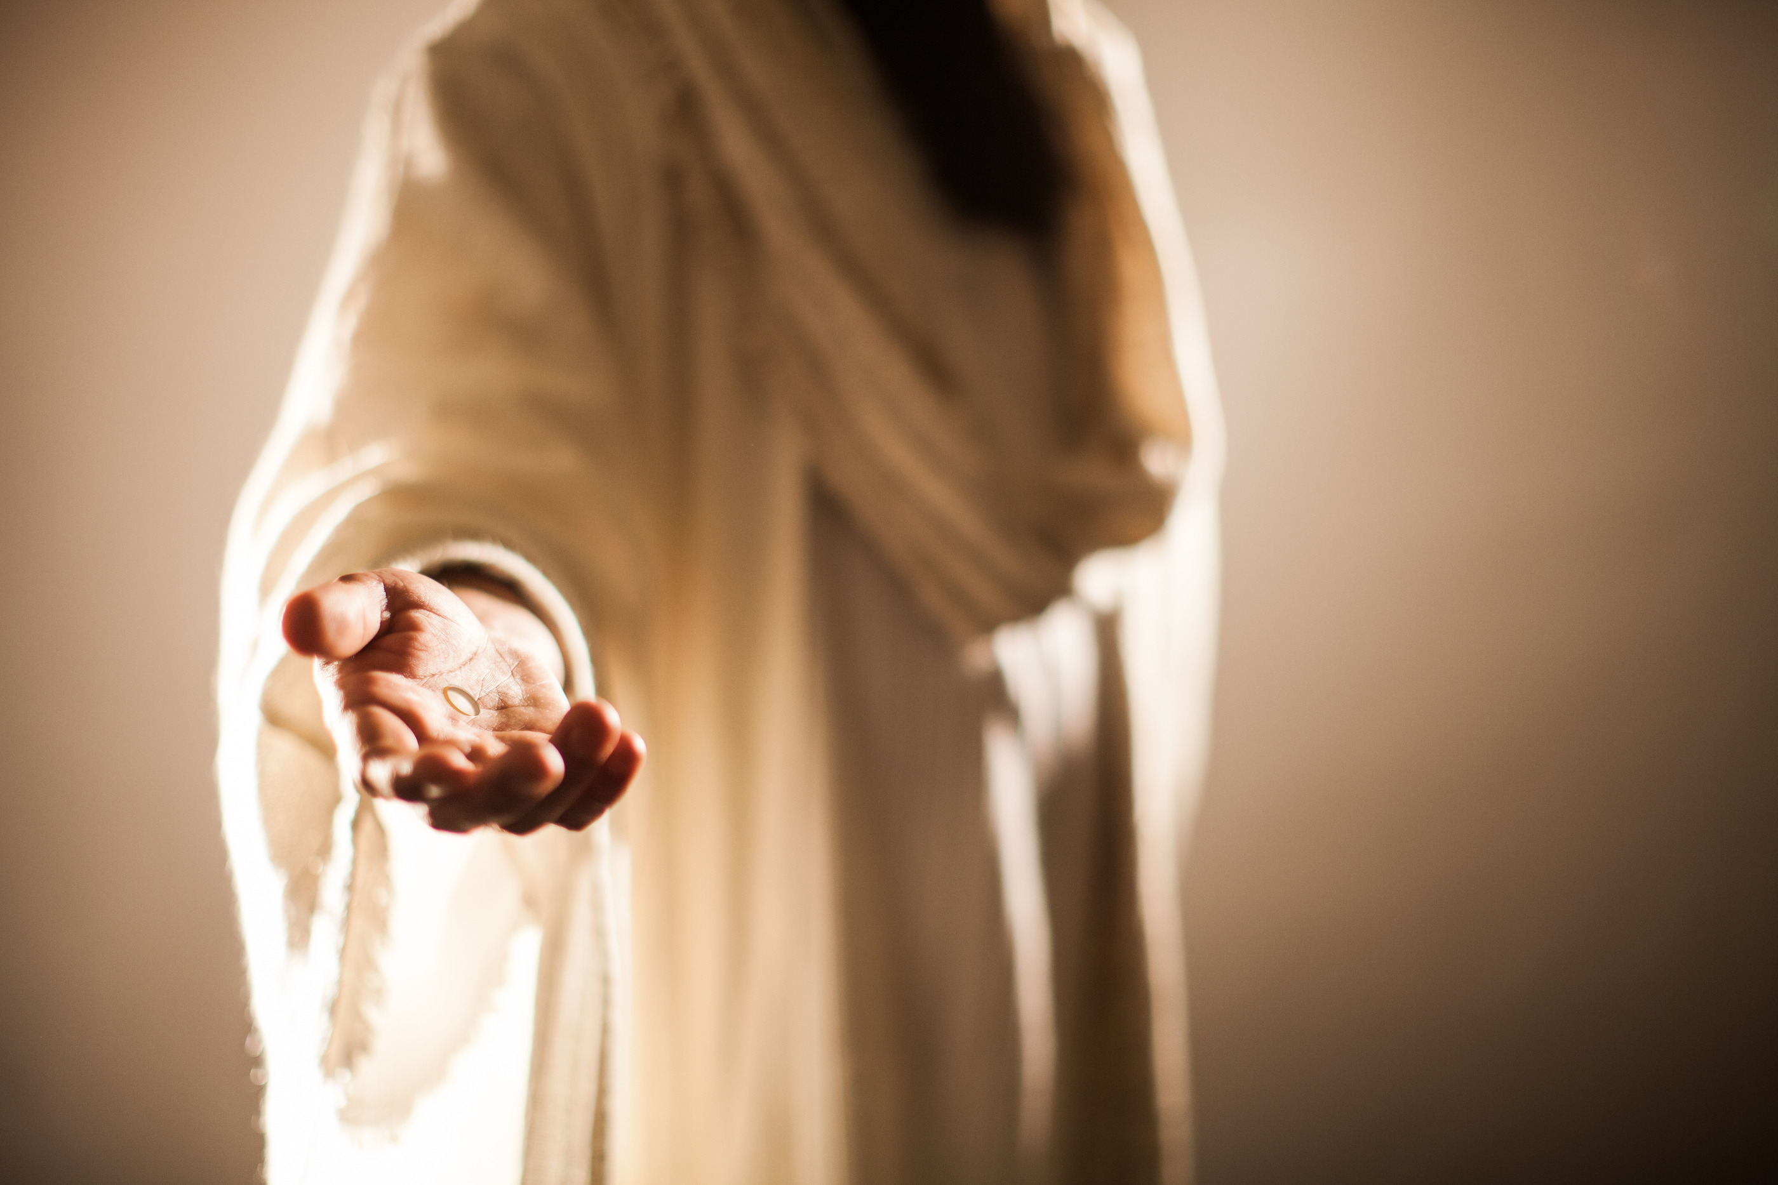
Jesus Loves Me
William Bradbury / Arr. Lisa Varner Nelson & Tim Zimmerman
Notes:
Move to the next slide when Tim starts talking again.

Slide 44
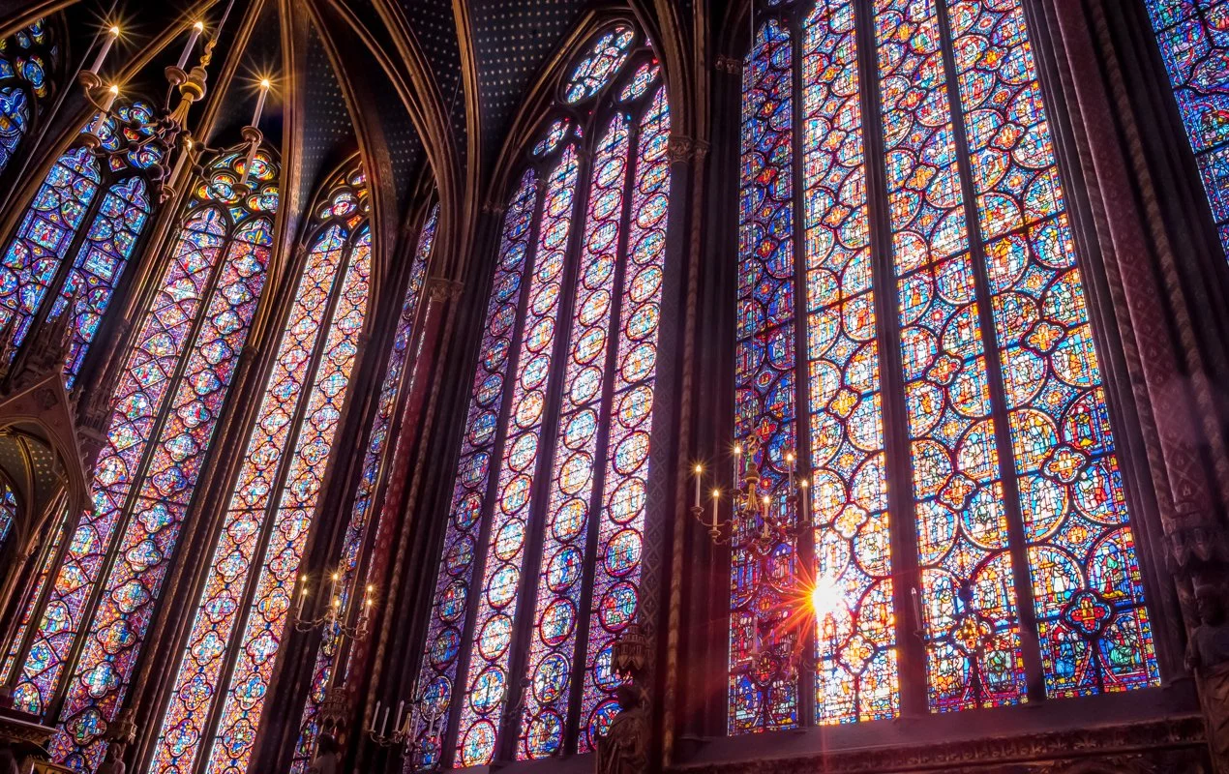
Christ the Lord is Risen Today
Traditional / Arr. Tim Zimmerman

Slide 45
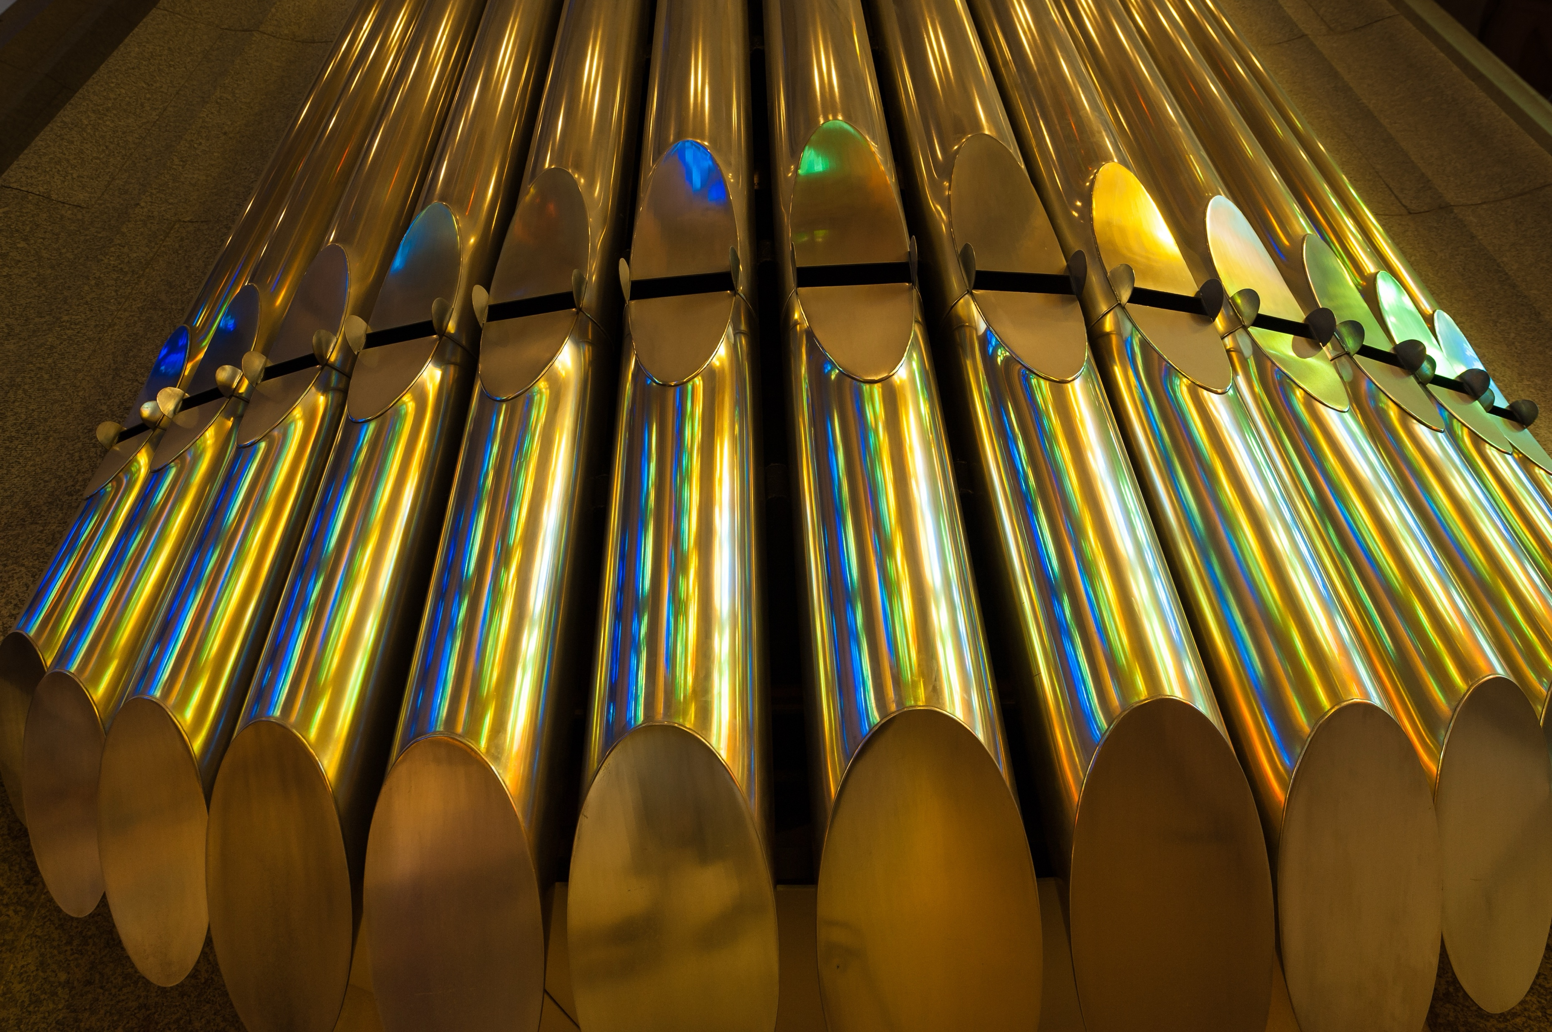
Nun danket alle Gott (Organ Piece)
Sigfried Karg-Elert

Slide 46
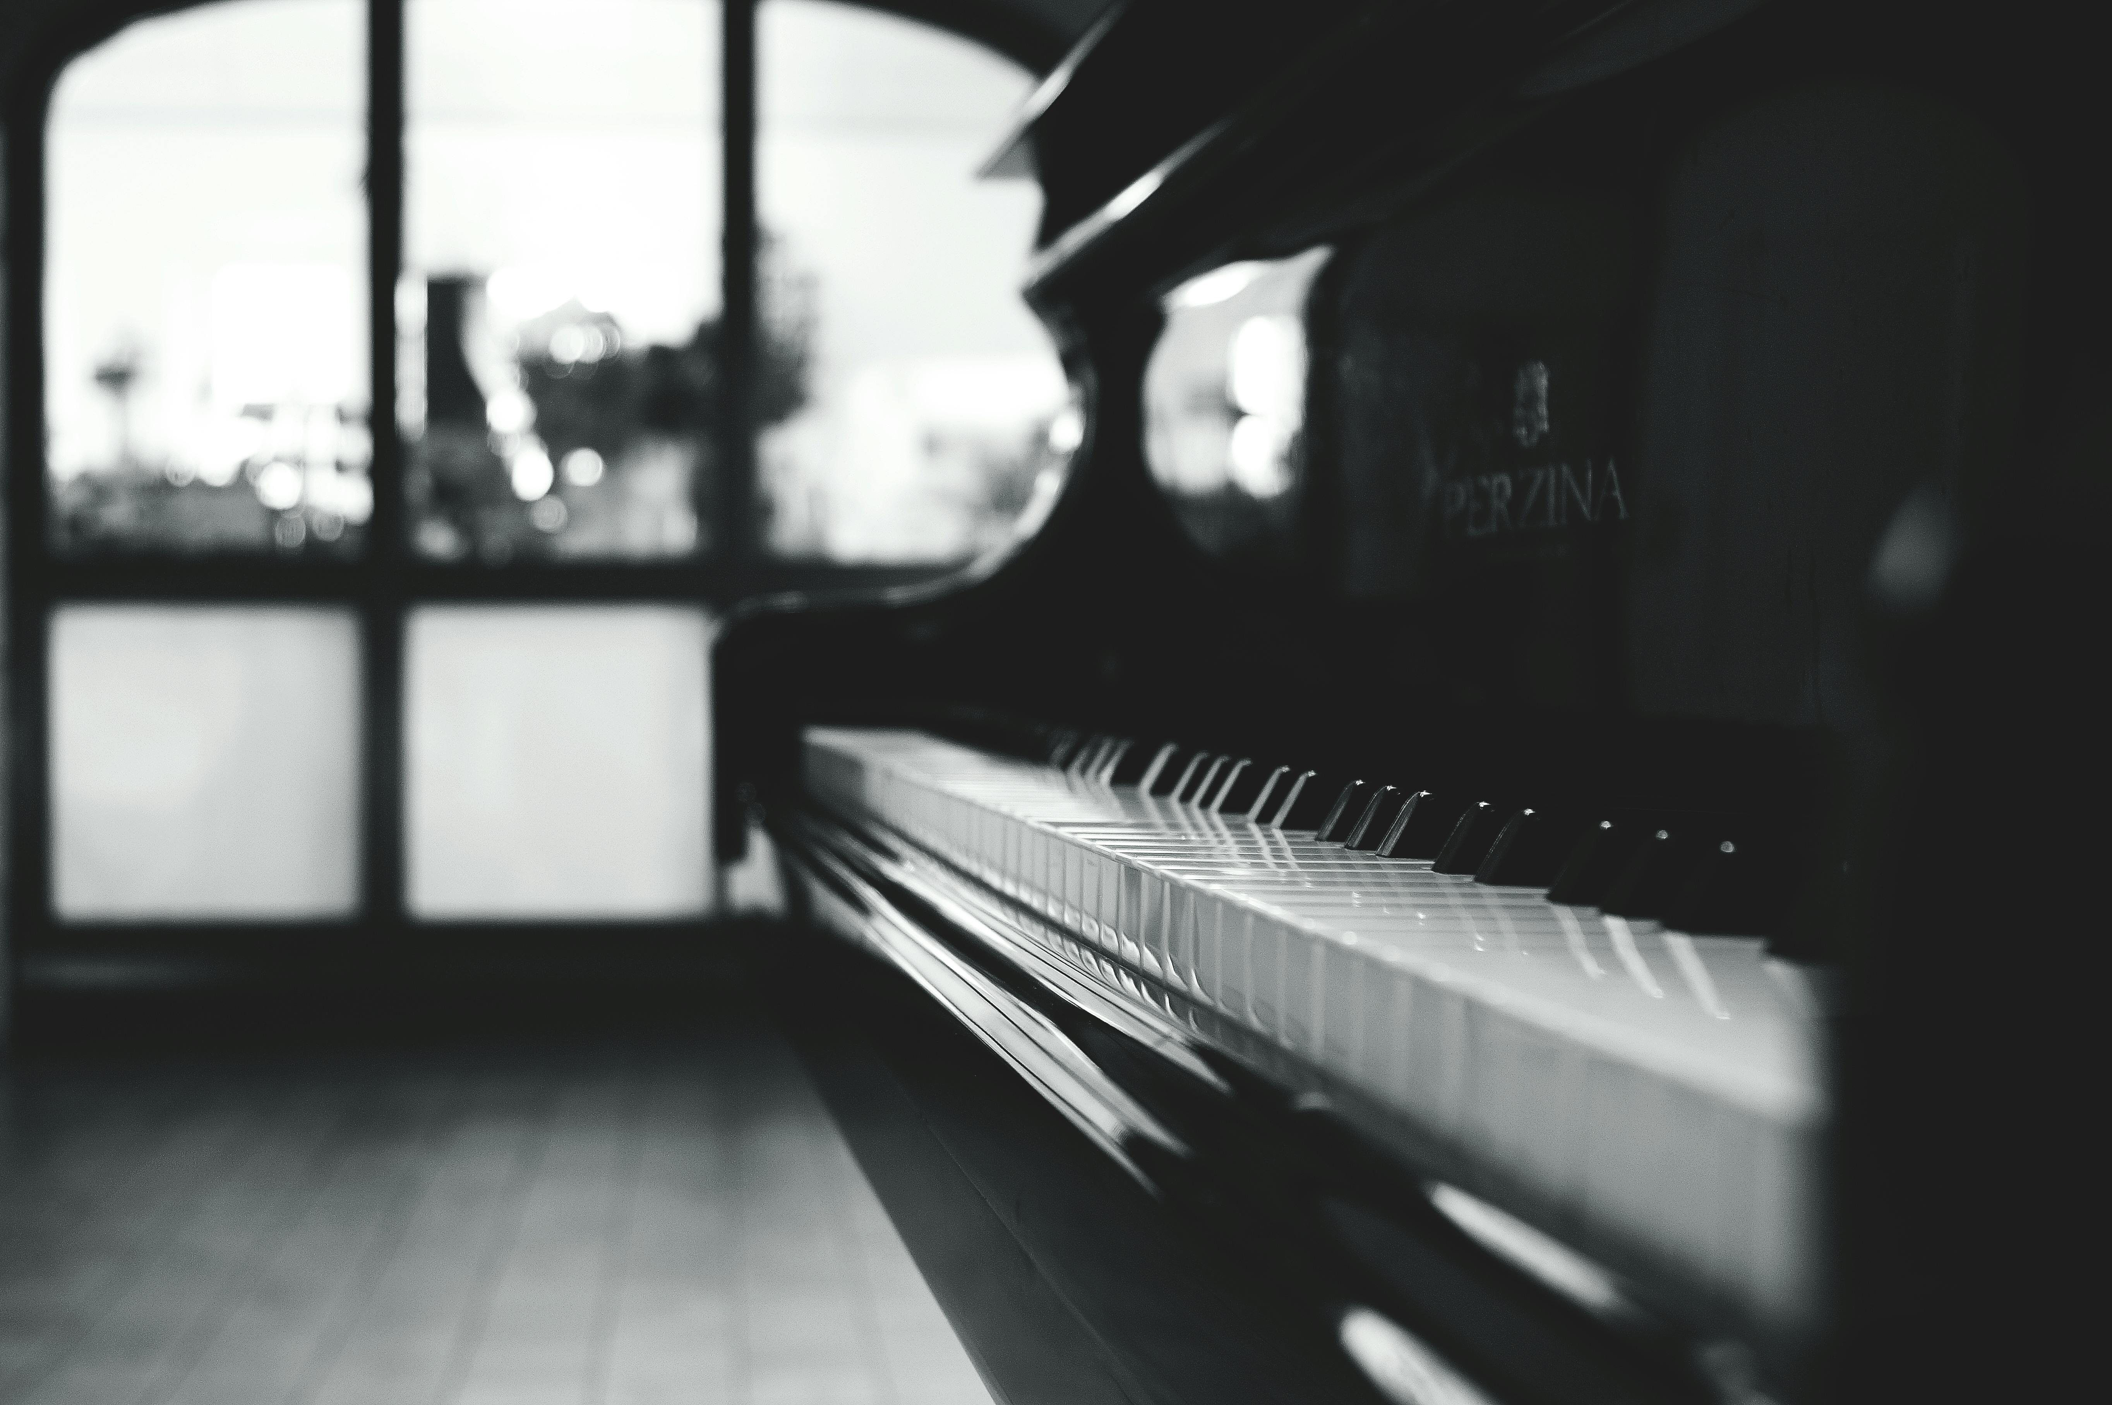
Blessed Assurance
Fanny Crosby / Arr. Lenny Seidel

Slide 47
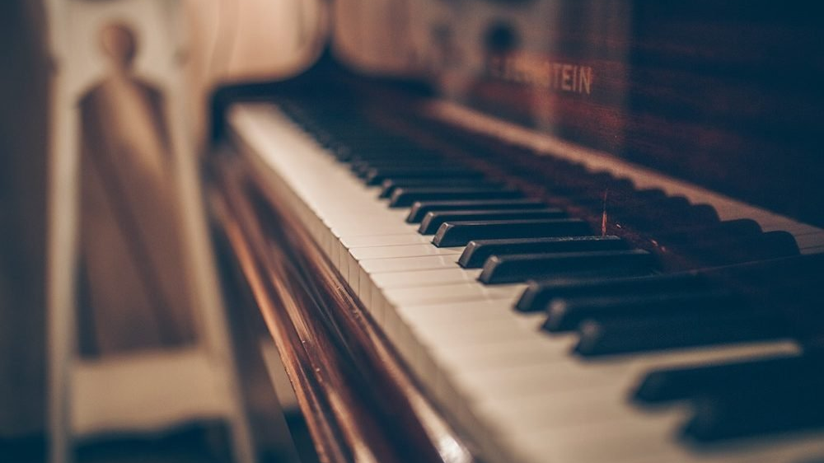
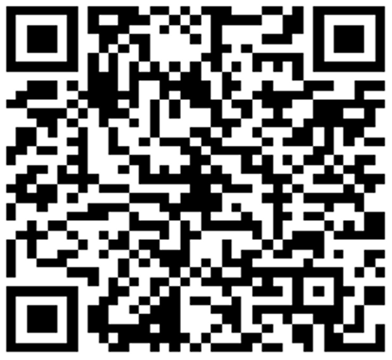
Offertory
If you would like to give online to the King’s Brass via credit card, turn on your smartphone’s camera and point it toward this QR code. Follow the link to the website on your browser where you can give.

Slide 48
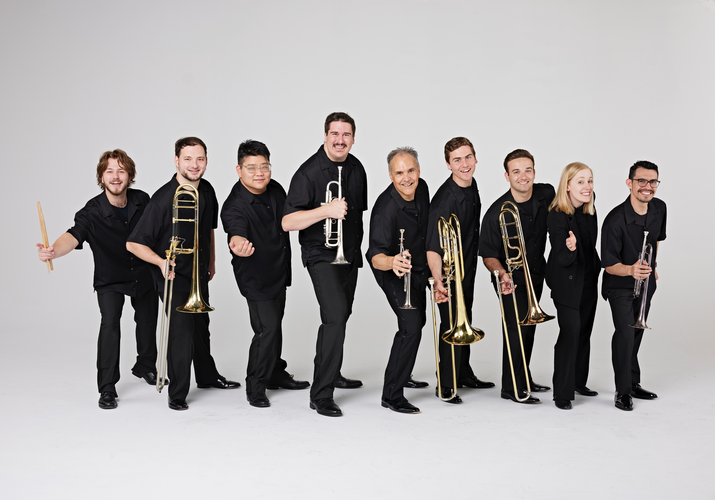
Intermission

Slide 49
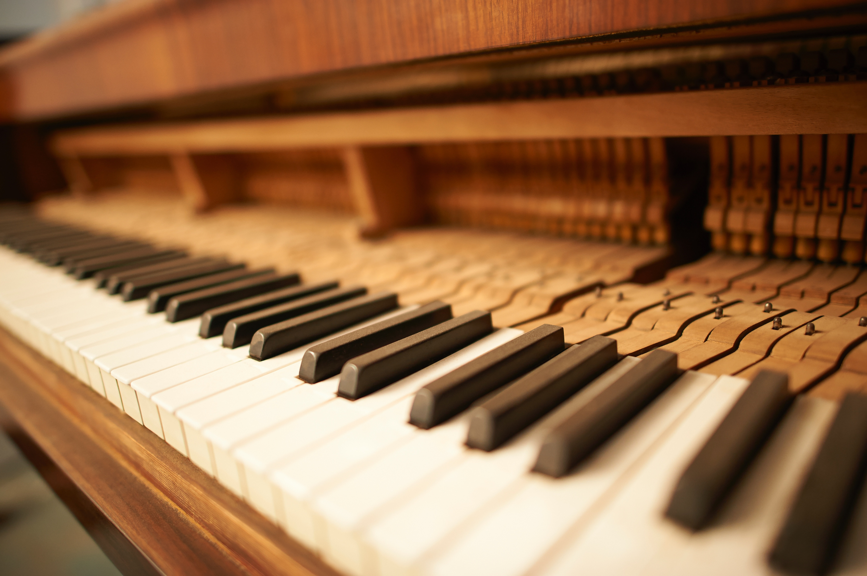
Concert Study No. 3 “Toccatina”
Nikolai Kapustin
Notes:
After this solo, move to “Down By The Riverside” when you hear the brass walking down the aisle.

Slide 50

Down by the Riverside
Traditional Spiritual / Arr. David Gravesen
Notes:
There are two halves: a slow first, and faster second. The audience will clap at the end of the slow one, thinking it is over. Do not change slides. WAIT until the faster half is done.

Slide 51

Group Parable – The Vacuum Cleaner
John Duckworth
Want a vacuum cleaner???
Notes:
When music starts at the end of the skit, move to the next slide.

Slide 52

Amazing Grace
Traditional / Arr. Dan Marvin
Notes:
Please do not show lyrics when you hear music. WAIT until Tim says “Please STAND and join us in singing…” before showing lyrics on the next slide.

Slide 53
Amazing grace! How sweet the sound
That saved a wretch like me!

Slide 54
I once was lost but now am found;
Was blind, but now I see.

Slide 55
'Twas grace that taught my heart to fear,
And grace my fears relieved.

Slide 56
How precious did that grace appear
The hour I first believed.

Slide 57
When we’ve been there ten thousand years,
Bright shining as the sun,

Slide 58
We’ve no less days to sing God’s praise
Than when we’d first begun.
© Public Domain
Notes:
Move to next slide after the audience sings “BEGUN.”

Slide 59
Notes:
Leave BLANK until Tim finishes talking and starts playing. Will take about 5 minutes.

Slide 60

You Are My All In All
D. Jernigan / Arr. Lisa Varner Nelson
Notes:
Please WAIT until Tim says “Join us…” to start the lyrics.

Slide 61
You are my strength when I am weak,
You are the treasure that I seek;
You are my all in all.

Slide 62
Seeking You as a precious jewel,
Lord, to give up, I’d be a fool;
You are my all in all.

Slide 63
Jesus, Lamb of God, Worthy is Your Name!
Jesus, Lamb of God, Worthy is Your Name!
© 1990 Shepherd’s Heart Music
Notes:
Move to next slide when audience sings the last ”Name”

Slide 64
Notes:
Leave blank until the audience applauses and Tim introduces the final song.

Slide 65
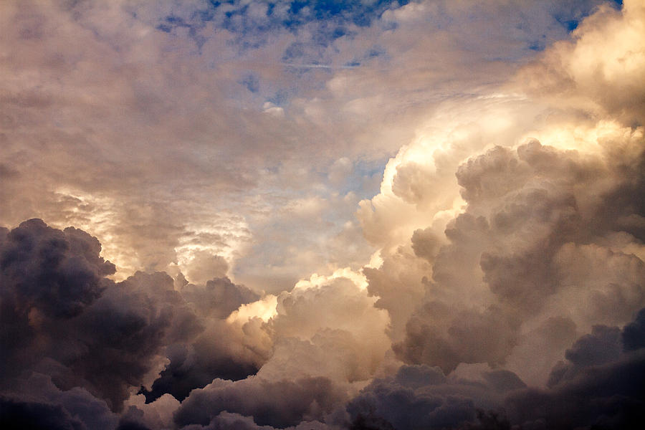
God of Our Fathers
George Warren / Arr. Tim Zimmerman
Notes:
Move to final slide after the applause.

Slide 66

O Happy Day
Traditional Spiritual / Arr. Lisa Varner Nelson
Notes:
Move to final slide after the applause.

Slide 67

Great Is The Lord
Michael W. and Deborah D. Smith / Arr. Bryan Nelson
Notes:
Move to final slide after the applause.

Slide 68
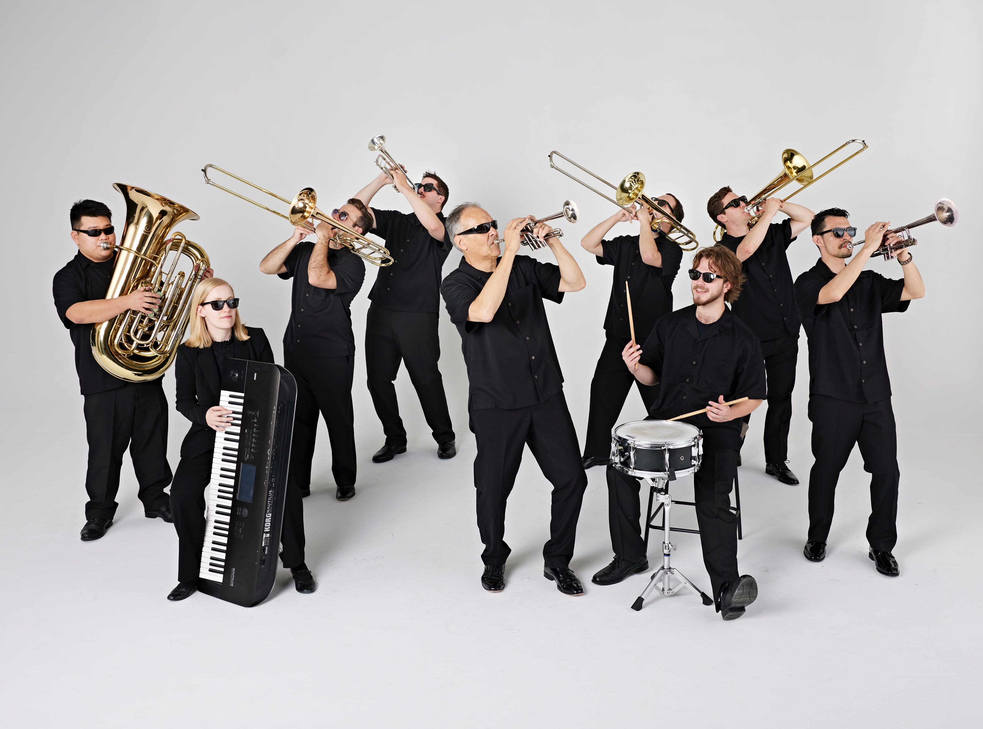
Tim Zimmerman &
The King’s Brass
Notes:
Leave here for remainder of concert. No slides needed for any encore pieces we play. Thanks for doing this! ☺

