Slide 1
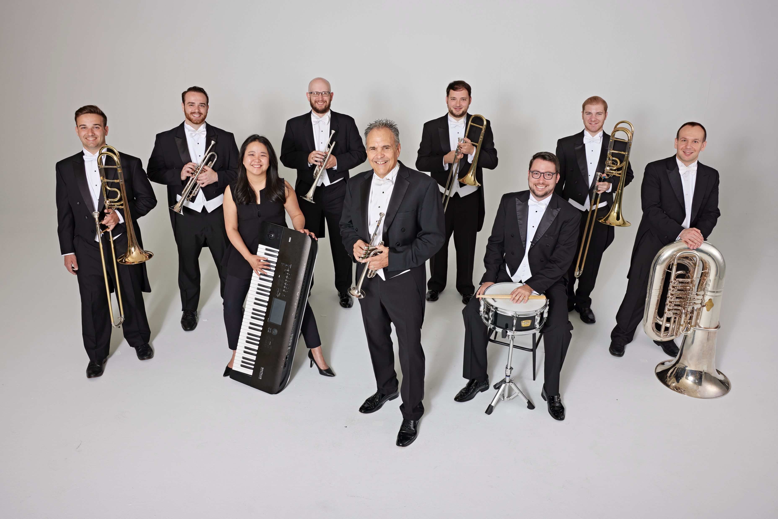
Tim Zimmerman & The King’s Brass

Slide 2
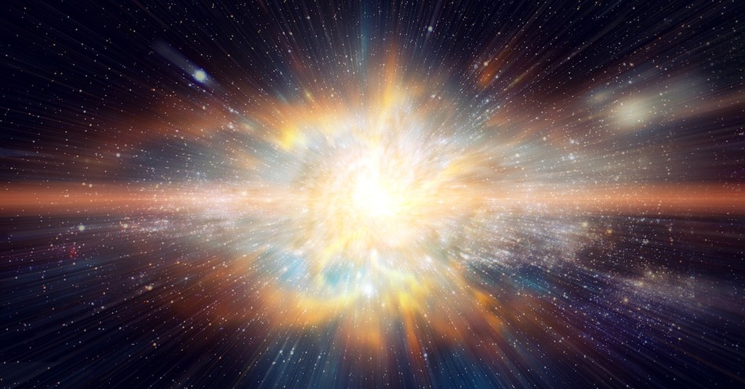
Psalm 19 Benedetto Marcello / Arr. David Gravesen
Notes:
After applause, immediately move to next slide.

Slide 3
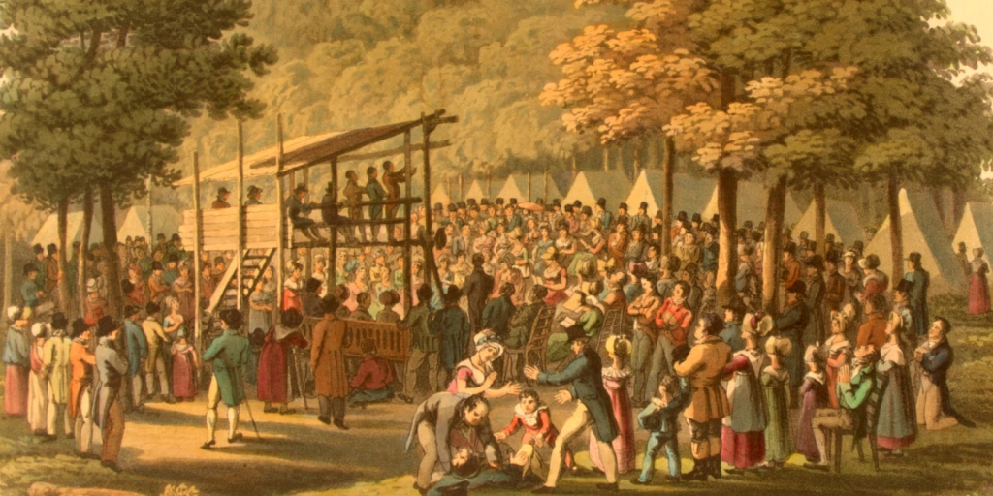
Camp Meeting Victory Eugene M. Bartlett, Sr. / Arr. Lisa Nelson
Notes:
WAIT until Tim says “Come Thou Almighty King” before next slide.

Slide 4
Come, Thou Fount of Every Blessing John Wyeth / Arr. Dan Marvin
Notes:
WAIT until Tim says “Come Thou Almighty King” before next slide.

Slide 5
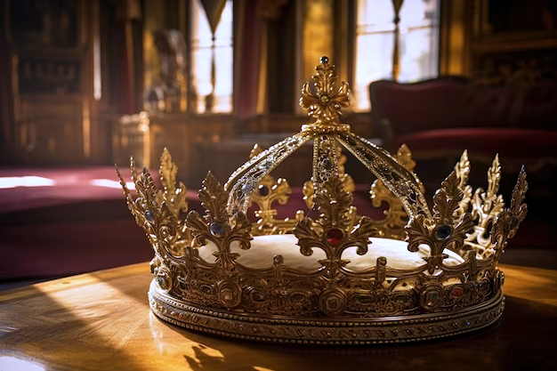
Come, Thou Almighty King Felice de Giardini / Arr. Lisa Nelson
Notes:
Nothing will be said after this song is over. Move to next slide.

Slide 6
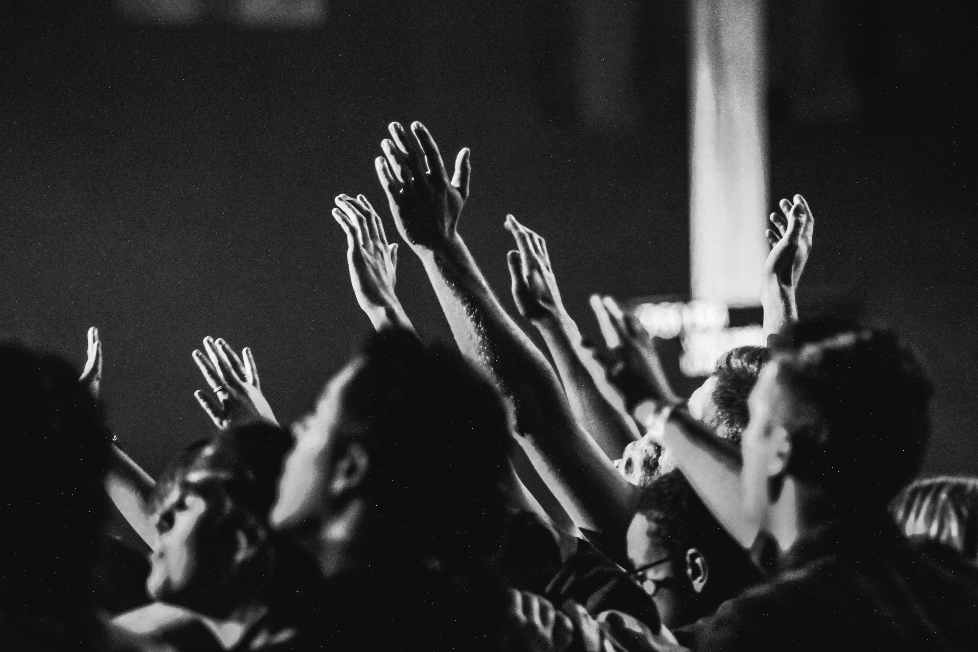
10,000 Reasons (Bless The Lord) Matt Redman / Arr. Ben Lynerd & Colton Morris

Slide 7
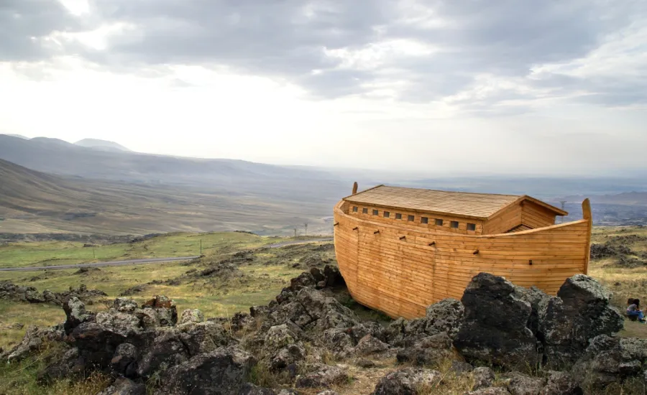
Arky, Arky – Kid’s Story Traditional / Arr. Lisa Nelson
Notes:
WAIT until King’s Brass member finishes introducing the “next set of typically American pieces” before moving to the next slide.

Slide 8
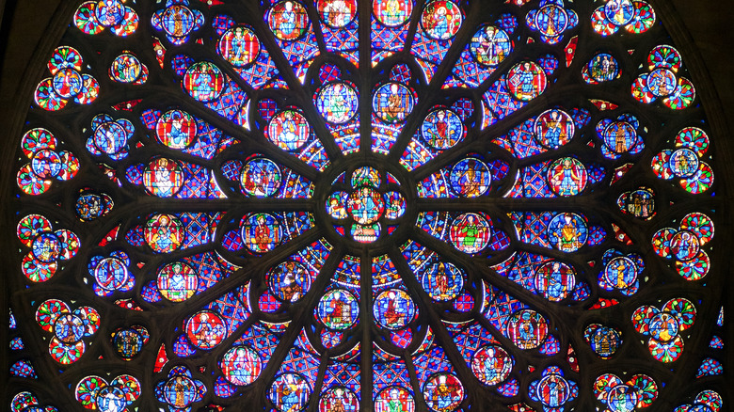
Holy, Holy, Holy John B. Dykes / Arr. Tim Zimmerman
Notes:
A KB member will tell the audience before the hymn to watch on stage for a cue after an opening fanfare. WAIT until Tim says “PLEASE STAND and join us in singing…” before showing the lyrics.

Slide 9
Holy, Holy, Holy! Lord God Almighty!

Slide 10
Early in the morning our song shall rise to Thee;

Slide 11
Holy, Holy, Holy! Merciful and Mighty!

Slide 12
God in Three Persons, blessed Trinity!

Slide 13
Holy, Holy, Holy! All the saints adore Thee,

Slide 14
Casting down their golden crowns around the glassy sea;

Slide 15
Cherubim and seraphim falling down before Thee,

Slide 16
Which wert, and art, and evermore shall be.

Slide 17
Holy, Holy, Holy! Though the darkness hide Thee,

Slide 18
Though the eye of sinful man, Thy glory may not see

Slide 19
Only Thou art holy, there is none beside Thee,

Slide 20
Perfect in pow’r In love and purity.

Slide 21
Holy, Holy, Holy! Lord God Almighty!

Slide 22
All Thy works shall praise Thy name in earth, and sky, and sea;

Slide 23
Holy, Holy, Holy! Merciful and Mighty!

Slide 24
God in Three Persons, blessed Trinity!
© Public Domain
Notes:
Move to next slide IMMEDIATELY AFTER audience sings “trinity.”

Slide 25
Notes:
Leave on this slide until end of the final fanfare.

Slide 26
I Love to Tell the Story William G. Fischer / Arr. Bruce Stevenson

Slide 27
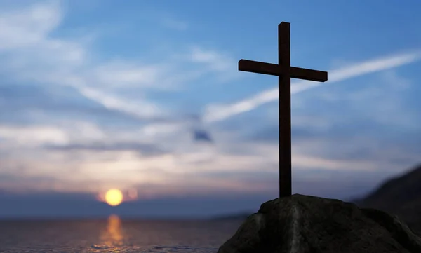
And Can It Be? Thomas Campbell / Arr. Tim Zimmerman

Slide 28
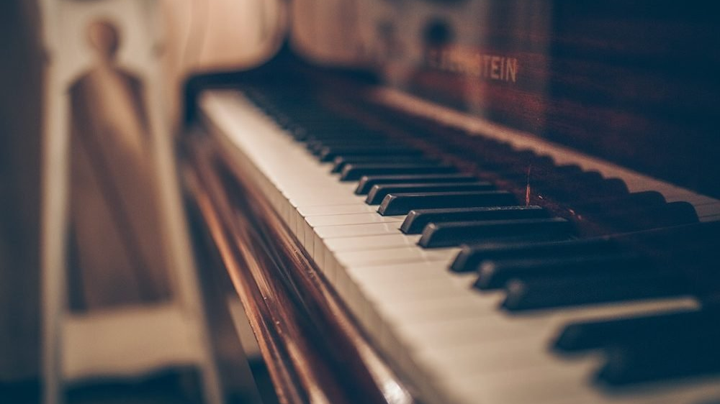
Offertory - Keyboard Solo

Slide 29
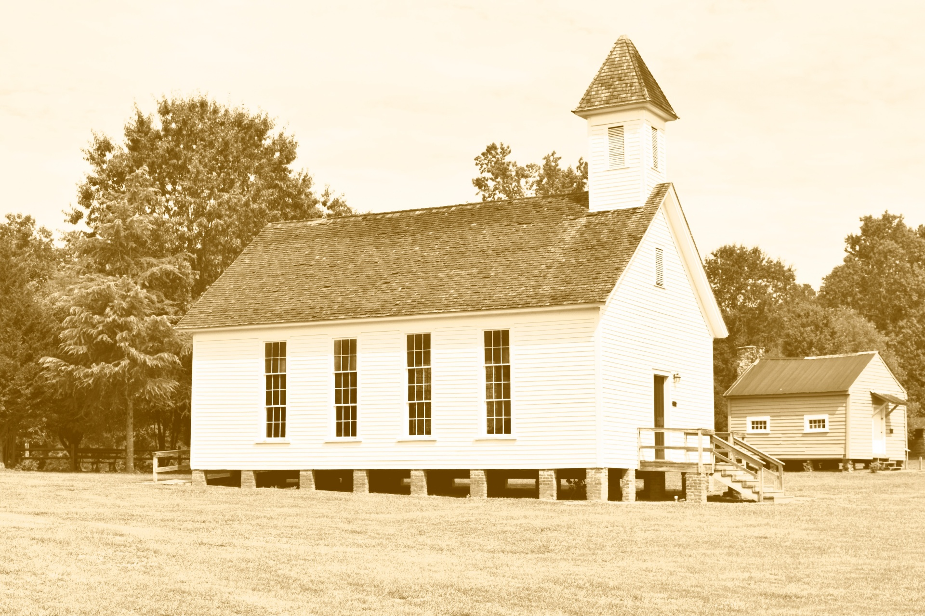
Old-Time Religion Traditional / Arr. Tim Zimmerman
Notes:
There are two halves: a slow first, and faster second. The audience will clap at the end of the slow one, thinking it is over. Do not change slides. WAIT until the faster half is done.

Slide 30
The New Ump (Group Parable) John Duckworth
Notes:
After the umpire says, “Can’t we all just get along?” move to next slide.

Slide 31
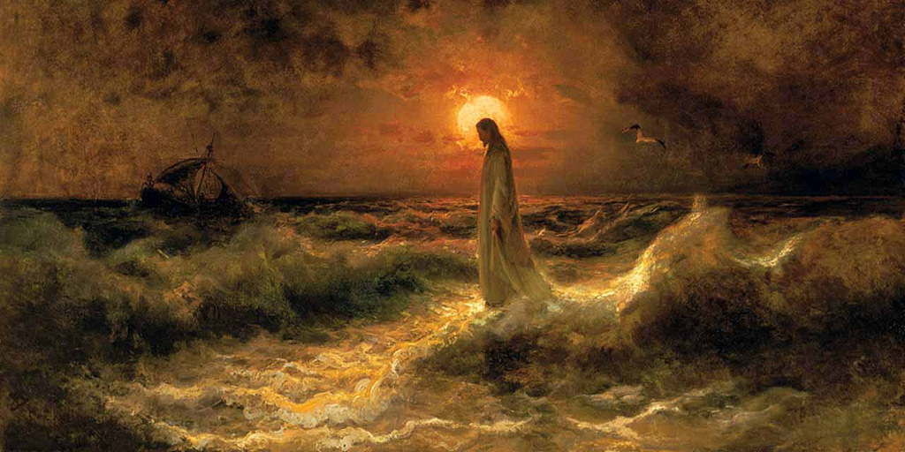
In Christ Alone Stuart Townend & Keith Getty / Arr. Lisa Nelson
Notes:
The audience does not sing until halfway through the piece. WAIT until Tim says “Please STAND and join us in singing…” before showing lyrics on the next slide.

Slide 32
In Christ alone my hope is found, He is my light, my strength, my song

Slide 33
This Cornerstone, this solid Ground Firm through the fiercest drought and storm

Slide 34
What heights of love, what depths of peace When fears are stilled, when strivings cease!

Slide 35
My comforter, my All in All, Here in the love of Christ I stand

Slide 36
No guilt in life, no fear in death This is the power of Christ in me;

Slide 37
From life’s first cry to final breath, Jesus commands my destiny.

Slide 38
No power of hell, no scheme of man Can ever pluck me from His hand

Slide 39
'Till He returns or calls me home, Here in the power of Christ I’ll stand
© 2001 Thankyou Music
Notes:
Move to next slide immediately after audience sings “stand.”

Slide 40
Notes:
Leave BLANK until Tim finishes talking and starts playing. Will take about 5-6 minutes.

Slide 41
Goodness of God Johnson, Cash, Ingram, Fielding & Johnson Arr. Lisa Nelson
Notes:
Long introduction. WAIT until Tim says “Join us…”

Slide 42
I love You, Lord Oh, Your mercy never fails me

Slide 43
All my days, I’ve been held in Your hands

Slide 44
From the moment that I wake up, Until I lay my head

Slide 45
I will sing of the goodness of God

Slide 46
And all my life You have been faithful

Slide 47
All my life You have been so, so good

Slide 48
With every breath that I am able

Slide 49
I will sing of the goodness of God

Slide 50
And all my life You have been faithful

Slide 51
All my life You have been so, so good

Slide 52
With every breath that I am able

Slide 53
I will sing of the goodness of God
© 2018 Alletrop Music,
SHOUT! Music Publishing
All Rights Reserved.
Notes:
Move to next slide when audience sings “God.”

Slide 54
Notes:
Leave blank until the audience applauses and Tim introduces the final song.

Slide 55
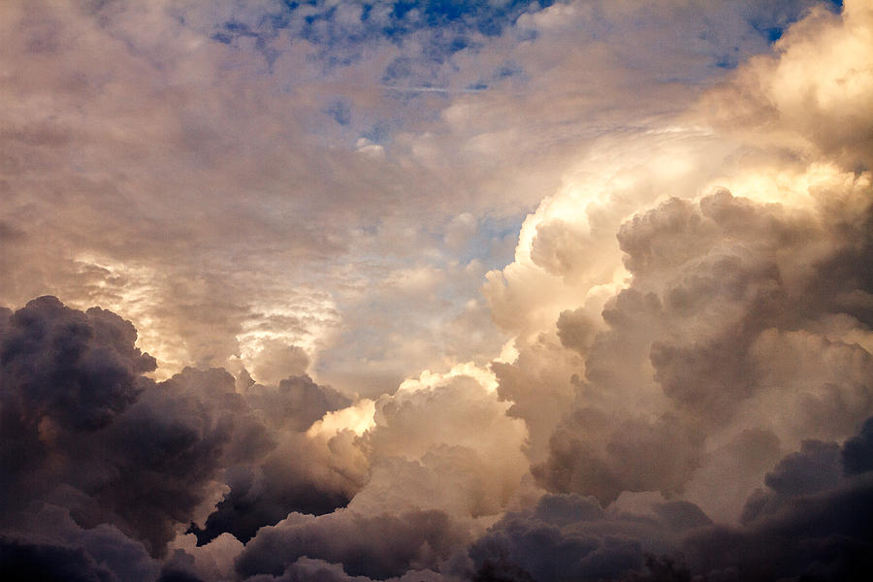
God of Our Fathers George Warren / Arr. Tim Zimmerman
Notes:
Move to final slide after the applause.

Slide 56
Cry of My Heart Terry Butler / Arr. Lisa Nelson
Notes:
Move to final slide after the applause.

Slide 57
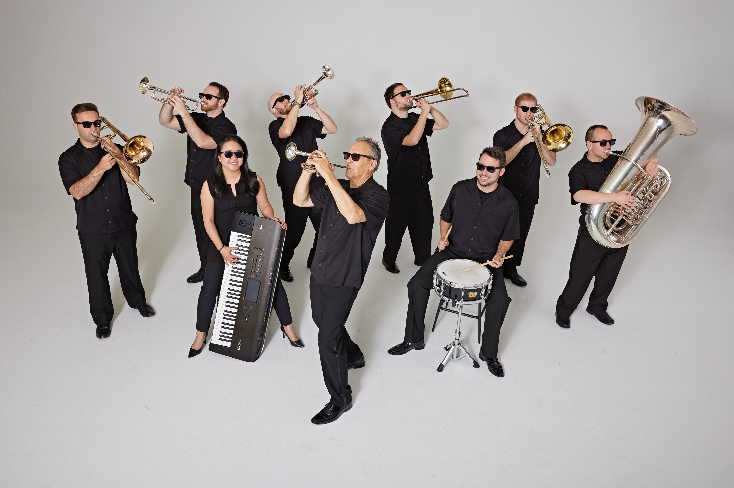
Tim Zimmerman & The King’s Brass

