Slide 1
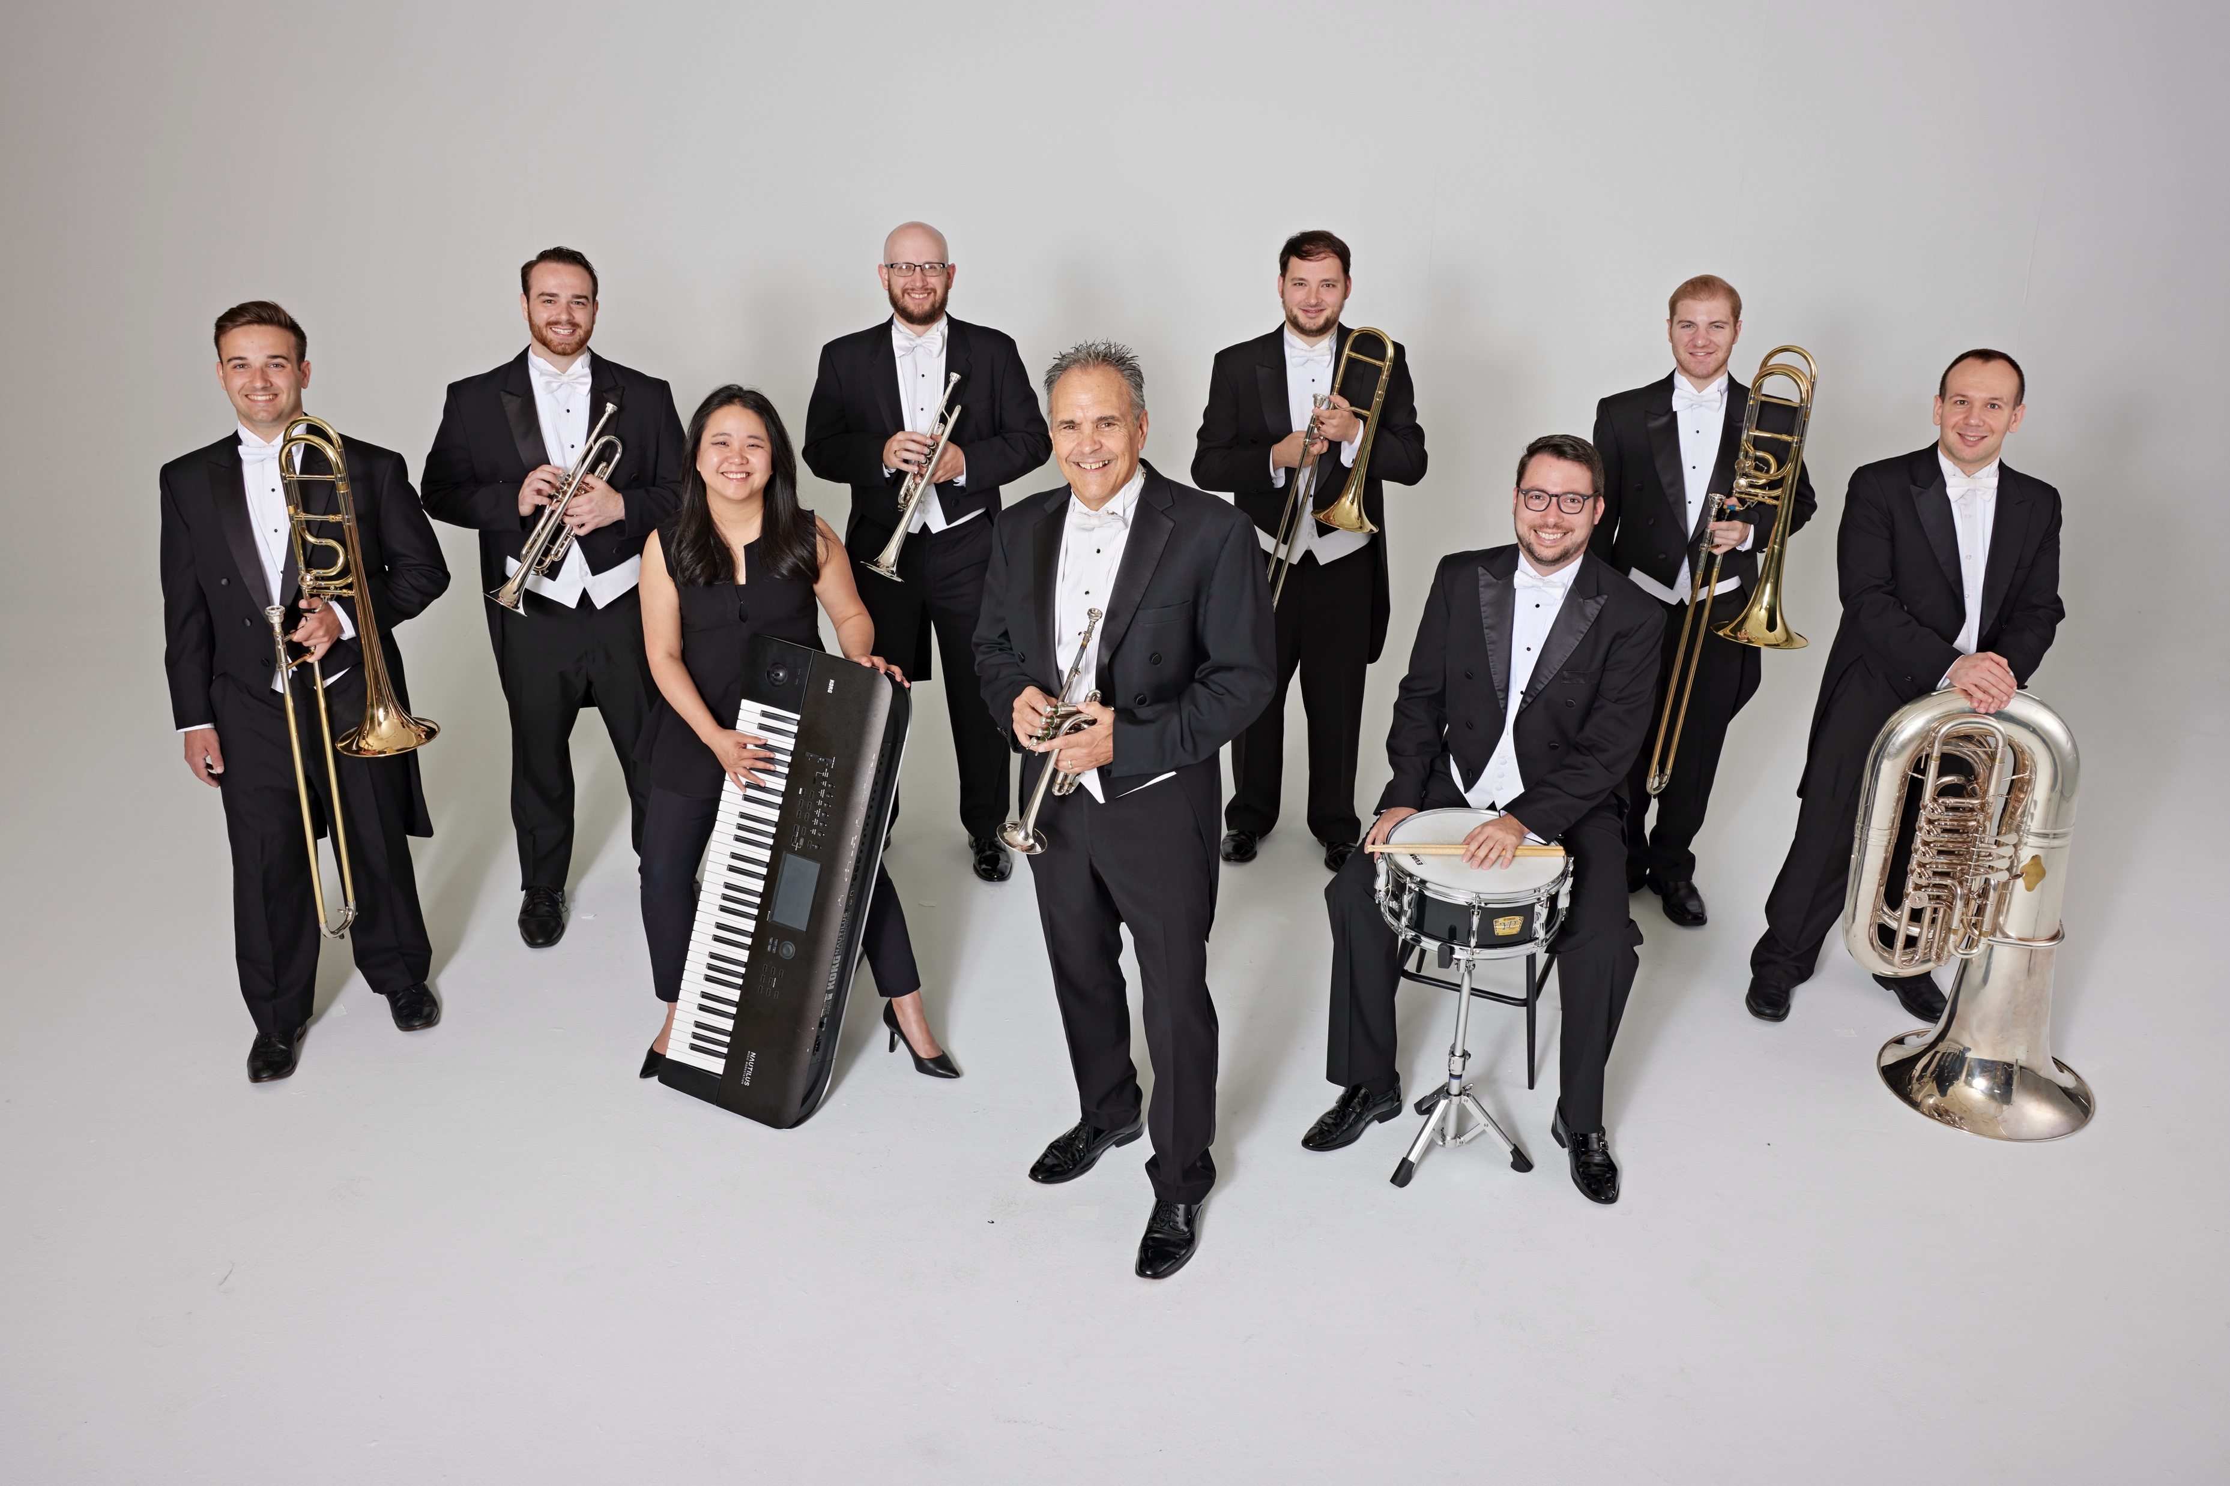
Tim Zimmerman & The King’s Brass

Slide 2
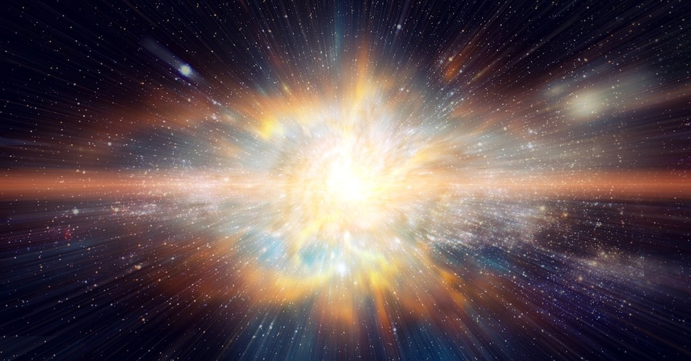
Psalm 19 Benedetto Marcello / Arr. David Gravesen
Notes:
After applause, immediately move to next slide.

Slide 3
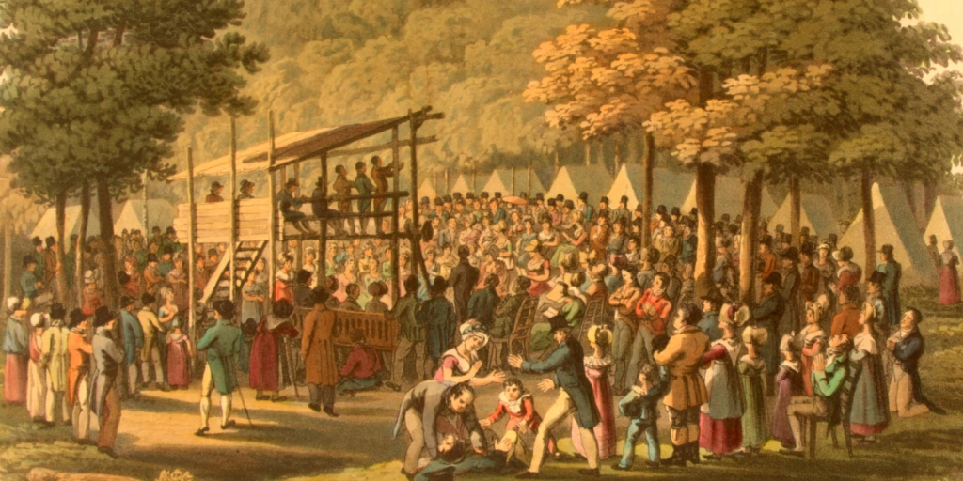
Camp Meeting Victory Eugene M. Bartlett, Sr. / Arr. Lisa Nelson
Notes:
WAIT until Tim says “Come Thou Almighty King” before next slide.

Slide 4
Come, Thou Fount of Every Blessing John Wyeth / Arr. Dan Marvin
Notes:
WAIT until Tim says “Come Thou Almighty King” before next slide.

Slide 5
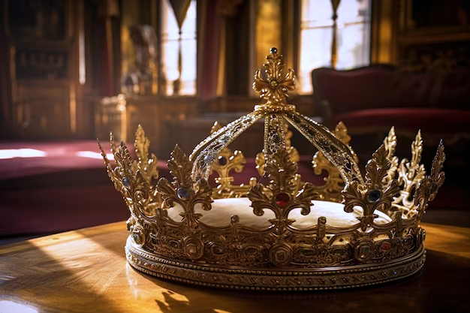
Come, Thou Almighty King Felice de Giardini / Arr. Lisa Nelson
Notes:
Nothing will be said after this song is over. Move to next slide.

Slide 6
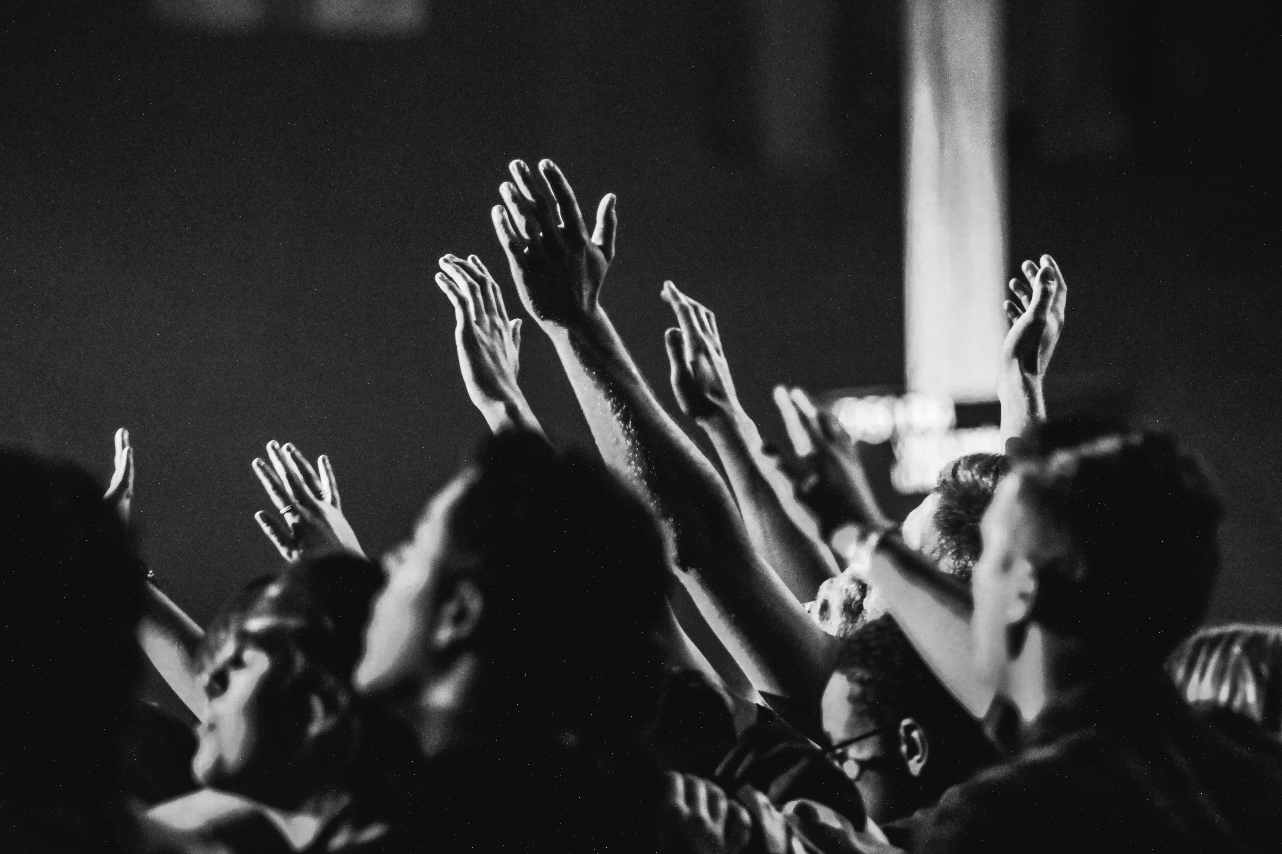
10,000 Reasons (Bless The Lord) Matt Redman / Arr. Ben Lynerd & Colton Morris

Slide 7
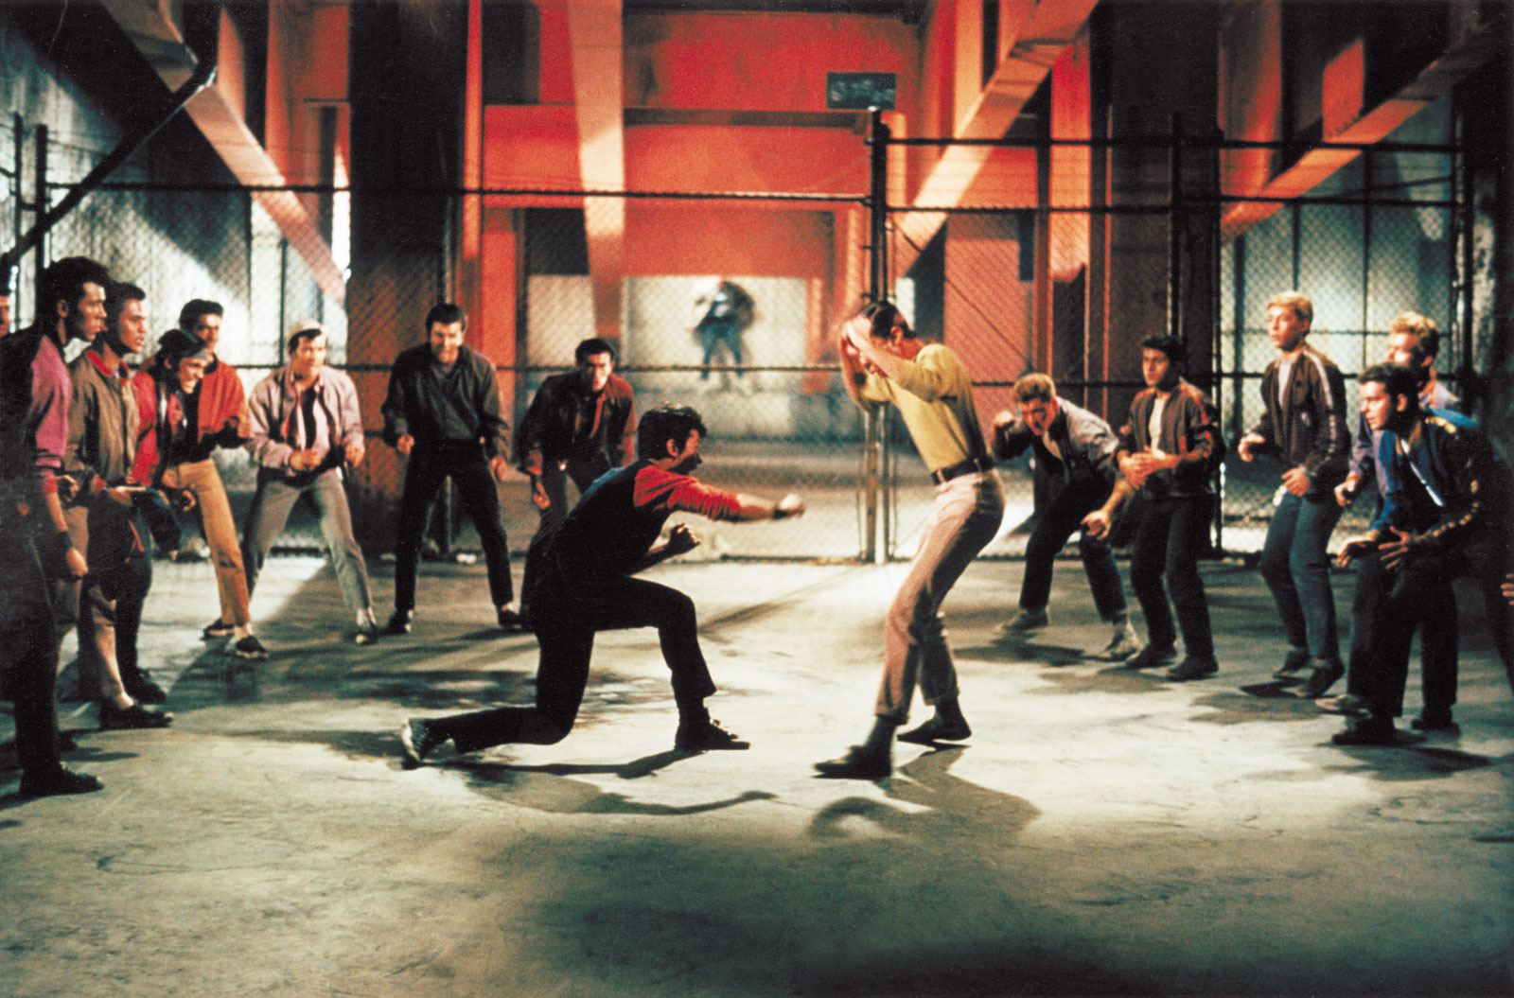
“America” from West Side Story Leonard Bernstein / Arr. Ardis Faber

Slide 8
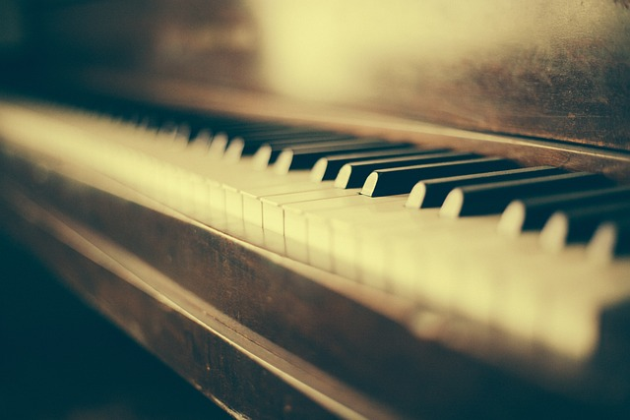
Keyboard Solo
Notes:
WAIT until Tim introduces the Keyboards before moving to “Arky, Arky.”

Slide 9
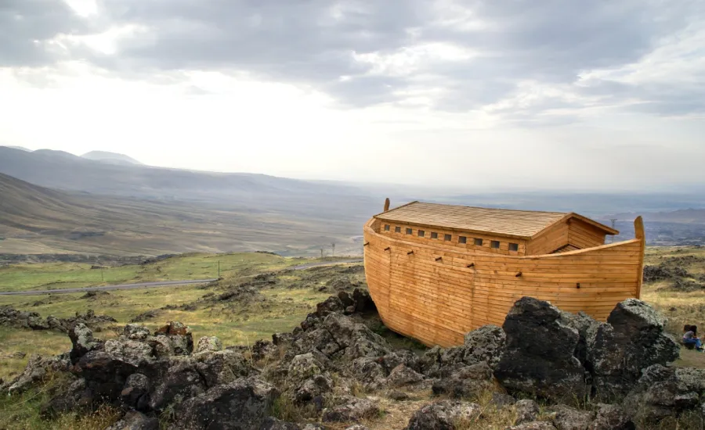
Arky, Arky – Kid’s Story Traditional / Arr. Lisa Nelson
Notes:
WAIT until King’s Brass member finishes introducing the “next set of typically American pieces” before moving to the next slide.

Slide 10
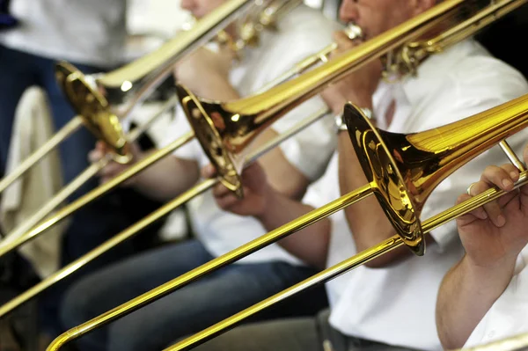
Seventy-Six Trombones Meredith Wilson / Arr. Ardis Faber

Slide 11
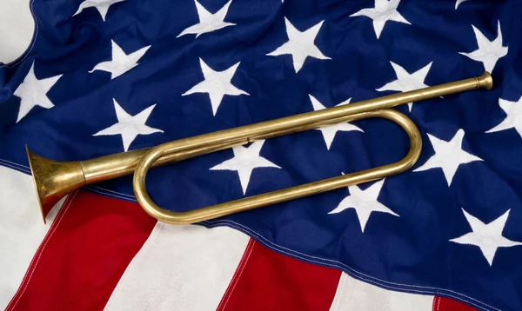
Boogie Woogie Bugle Boy Don Raye & Hughie Prince / Arr. Ardis Faber

Slide 12
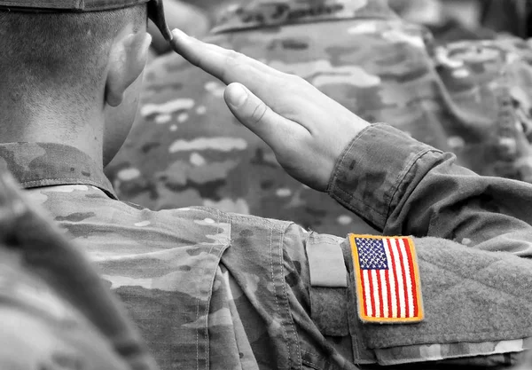
Armed Forces Salute Bob Lowden / Arr. Ardis Faber Army, Coast Guard, Marine Corps, Air Force, Navy

Slide 13
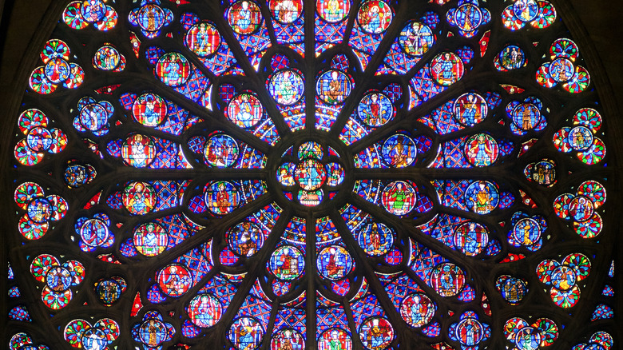
Holy, Holy, Holy John B. Dykes / Arr. Tim Zimmerman
Notes:
A KB member will tell the audience before the hymn to watch on stage for a cue after an opening fanfare. WAIT until Tim says “PLEASE STAND and join us in singing…” before showing the lyrics.

Slide 14
Holy, Holy, Holy! Lord God Almighty!

Slide 15
Early in the morning our song shall rise to Thee;

Slide 16
Holy, Holy, Holy! Merciful and Mighty!

Slide 17
God in Three Persons, blessed Trinity!

Slide 18
Holy, Holy, Holy! All the saints adore Thee,

Slide 19
Casting down their golden crowns around the glassy sea;

Slide 20
Cherubim and seraphim falling down before Thee,

Slide 21
Which wert, and art, and evermore shall be.

Slide 22
Holy, Holy, Holy! Though the darkness hide Thee,

Slide 23
Though the eye of sinful man, Thy glory may not see

Slide 24
Only Thou art holy, there is none beside Thee,

Slide 25
Perfect in pow’r In love and purity.

Slide 26
Holy, Holy, Holy! Lord God Almighty!

Slide 27
All Thy works shall praise Thy name in earth, and sky, and sea;

Slide 28
Holy, Holy, Holy! Merciful and Mighty!

Slide 29
God in Three Persons, blessed Trinity!
© Public Domain
Notes:
Move to next slide IMMEDIATELY AFTER audience sings “trinity.”

Slide 30
Notes:
Leave on this slide until end of the final fanfare.

Slide 31
I Love to Tell the Story William G. Fischer / Arr. Bruce Stevenson

Slide 32
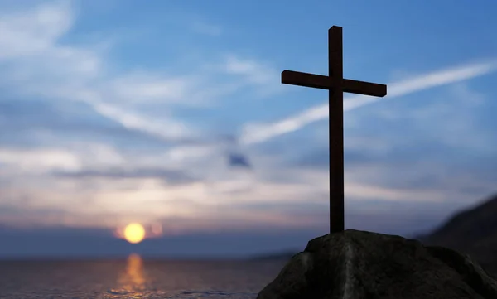
And Can It Be? Thomas Campbell / Arr. Tim Zimmerman

Slide 33
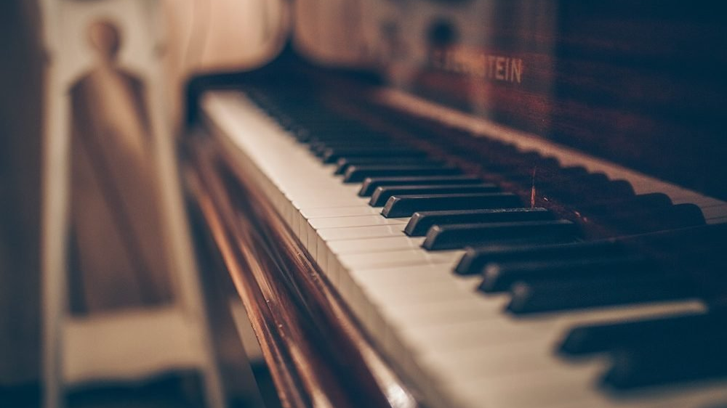
Keyboard Solo

Slide 34
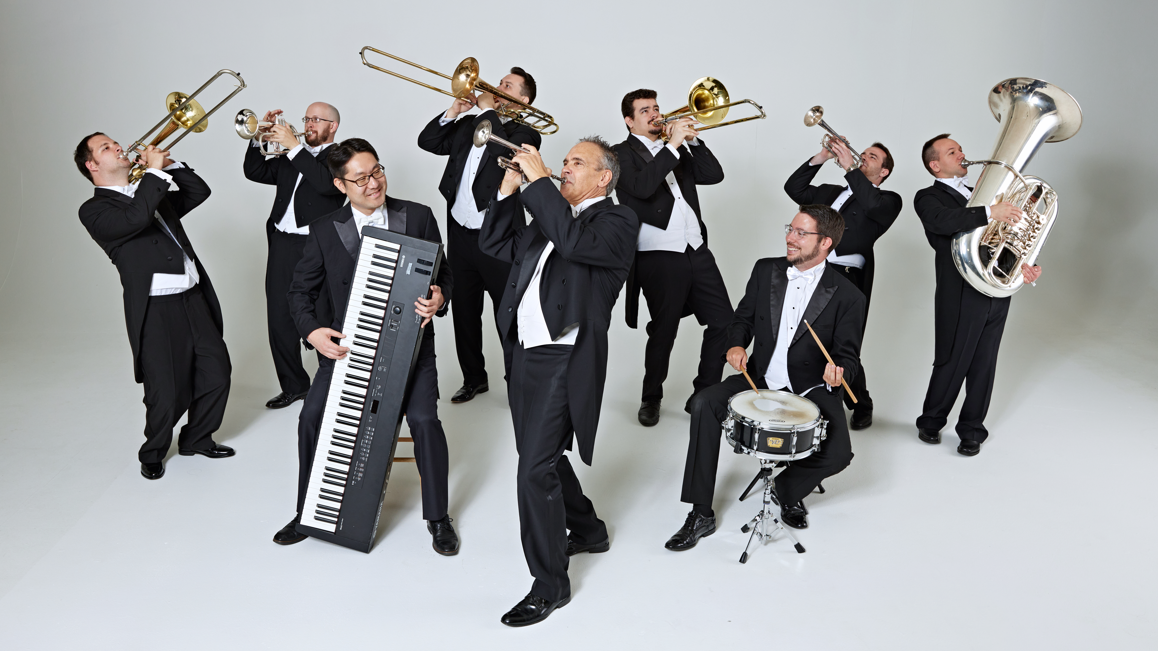
Intermission

Slide 35
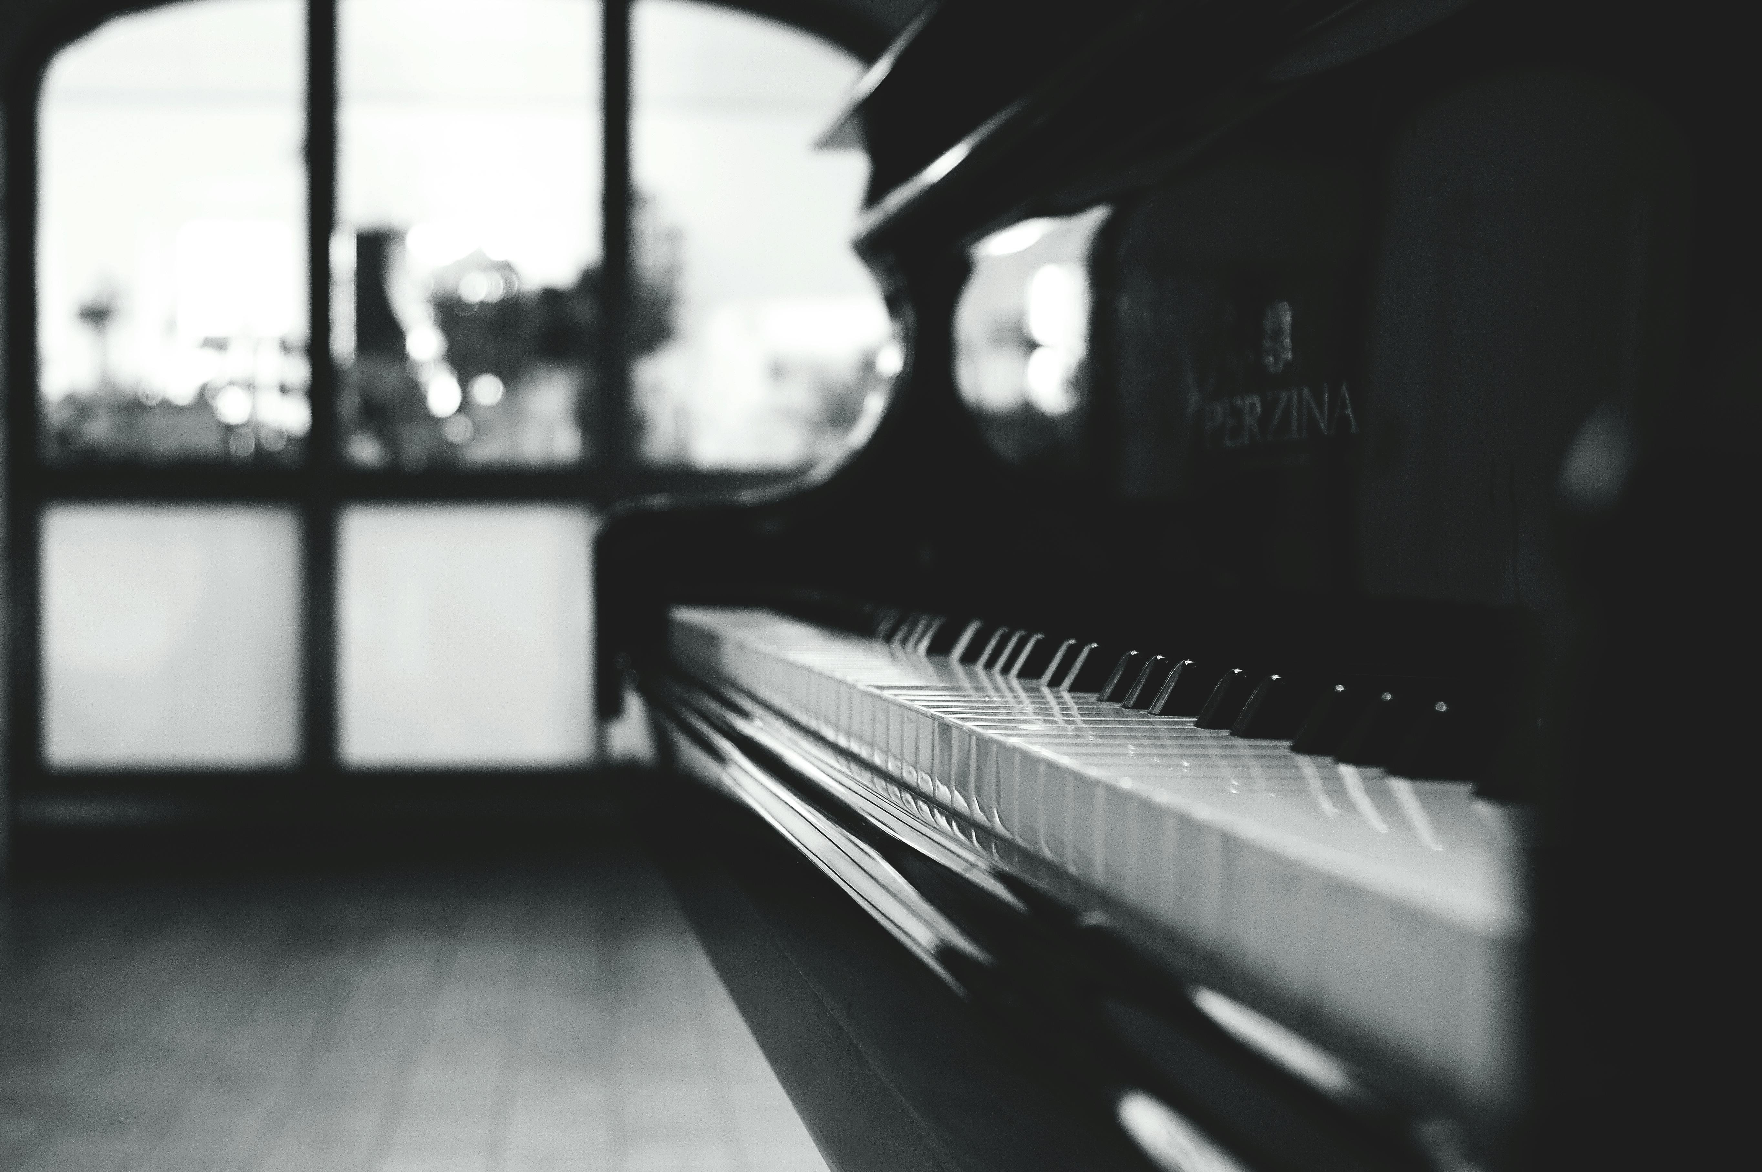
Keyboard Solo

Slide 36
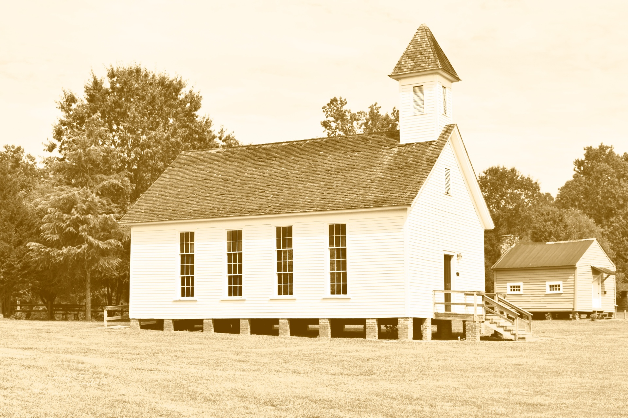
Old-Time Religion Traditional / Arr. Tim Zimmerman
Notes:
There are two halves: a slow first, and faster second. The audience will clap at the end of the slow one, thinking it is over. Do not change slides. WAIT until the faster half is done.

Slide 37
The New Ump (Group Parable) John Duckworth
Notes:
After the umpire says, “Can’t we all just get along?” move to next slide.

Slide 38
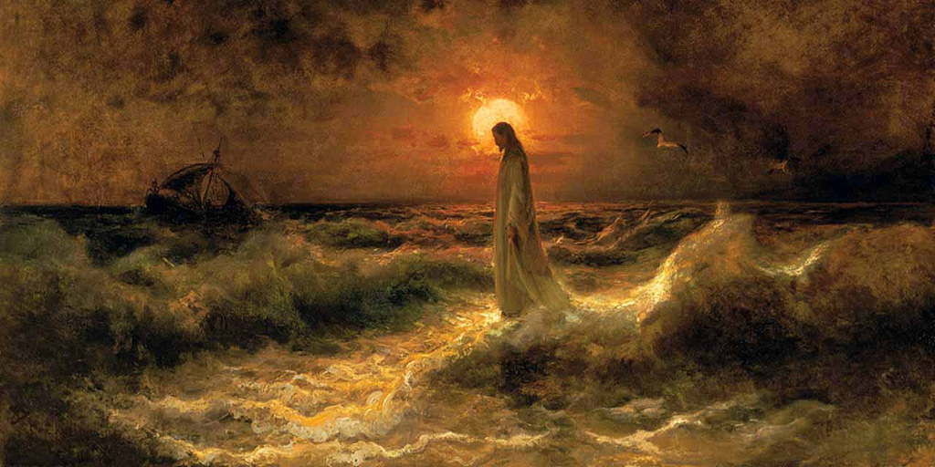
In Christ Alone Stuart Townend & Keith Getty / Arr. Lisa Nelson
Notes:
The audience does not sing until halfway through the piece. WAIT until Tim says “Please STAND and join us in singing…” before showing lyrics on the next slide.

Slide 39
In Christ alone my hope is found, He is my light, my strength, my song

Slide 40
This Cornerstone, this solid Ground Firm through the fiercest drought and storm

Slide 41
What heights of love, what depths of peace When fears are stilled, when strivings cease!

Slide 42
My comforter, my All in All, Here in the love of Christ I stand

Slide 43
No guilt in life, no fear in death This is the power of Christ in me;

Slide 44
From life’s first cry to final breath, Jesus commands my destiny.

Slide 45
No power of hell, no scheme of man Can ever pluck me from His hand

Slide 46
'Till He returns or calls me home, Here in the power of Christ I’ll stand
© 2001 Thankyou Music
Notes:
Move to next slide immediately after audience sings “stand.”

Slide 47
Notes:
Leave BLANK until Tim finishes talking and starts playing. Will take about 5-6 minutes.

Slide 48
Goodness of God Johnson, Cash, Ingram, Fielding & Johnson Arr. Lisa Nelson
Notes:
Long introduction. WAIT until Tim says “Join us…”

Slide 49
I love You, Lord Oh, Your mercy never fails me

Slide 50
All my days, I’ve been held in Your hands

Slide 51
From the moment that I wake up, Until I lay my head

Slide 52
I will sing of the goodness of God

Slide 53
And all my life You have been faithful

Slide 54
All my life You have been so, so good

Slide 55
With every breath that I am able

Slide 56
I will sing of the goodness of God

Slide 57
And all my life You have been faithful

Slide 58
All my life You have been so, so good

Slide 59
With every breath that I am able

Slide 60
I will sing of the goodness of God
© 2018 Alletrop Music,
SHOUT! Music Publishing
All Rights Reserved.
Notes:
Move to next slide when audience sings “God.”

Slide 61
Notes:
Leave blank until the audience applauses and Tim introduces the final song.

Slide 62
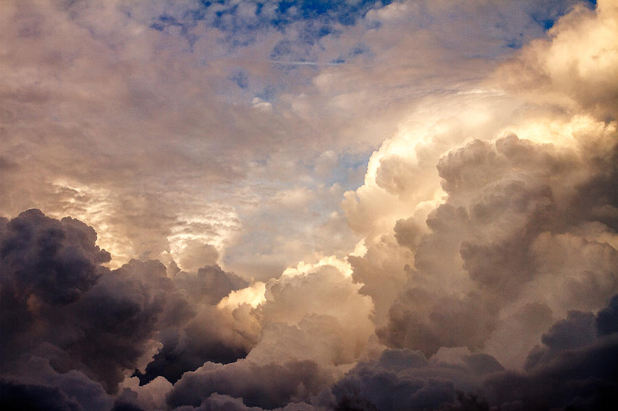
God of Our Fathers George Warren / Arr. Tim Zimmerman
Notes:
Move to final slide after the applause.

Slide 63
Cry of My Heart Terry Butler / Arr. Lisa Nelson
Notes:
Move to final slide after the applause.

Slide 64
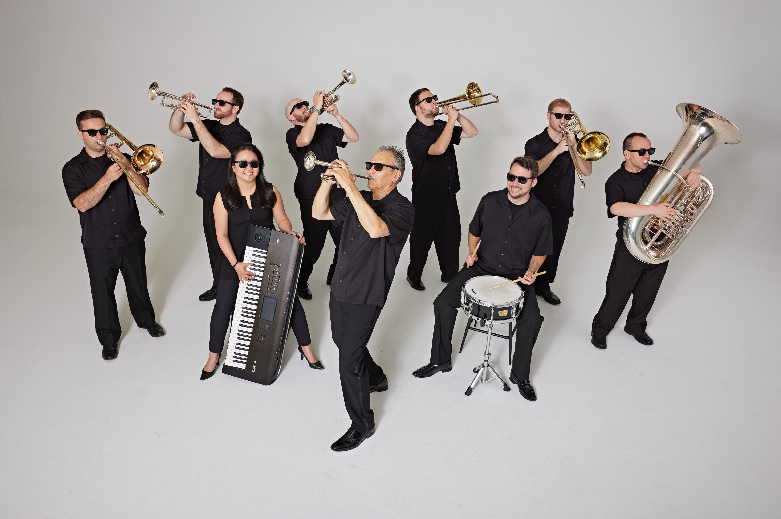
Tim Zimmerman & The King’s Brass

